Slide 1
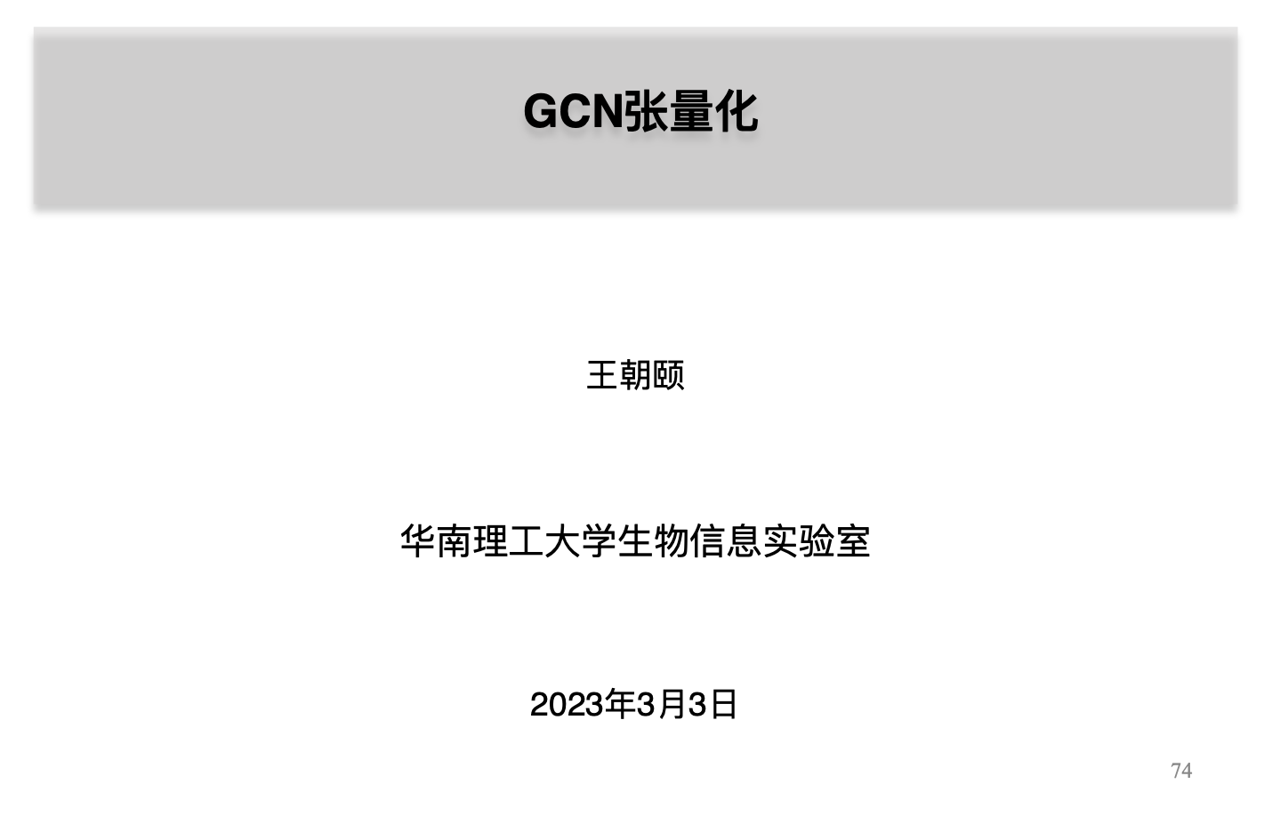
Notes:
Someone may want to ask what salient object detection means and how to define the salient object. The saliency detection is to find clear foreground objects that are significantly different from the surrounding background in the image. The differences can be reflected in the color, texture and object shape. Let‘s see the first row in the figure. The input of the salient object detection is a digitized image and the output is a saliency probability map as in the second row. Each pixel of the input image has a calculated probability value in the probability map. The probability value is bigger, the probability is
higher that the pixel belongs to the salient object. Otherwise , if the probability value is small, it indicates a higher probability that the pixel belongs to the background. Generally, in the practical application, we apply a constant value in the probability map to separate the salient object from the input image. Just like the third row in the figure. Salient object detection can be used in many fields, like visual tracking, video matting and robot navigation.

Slide 2
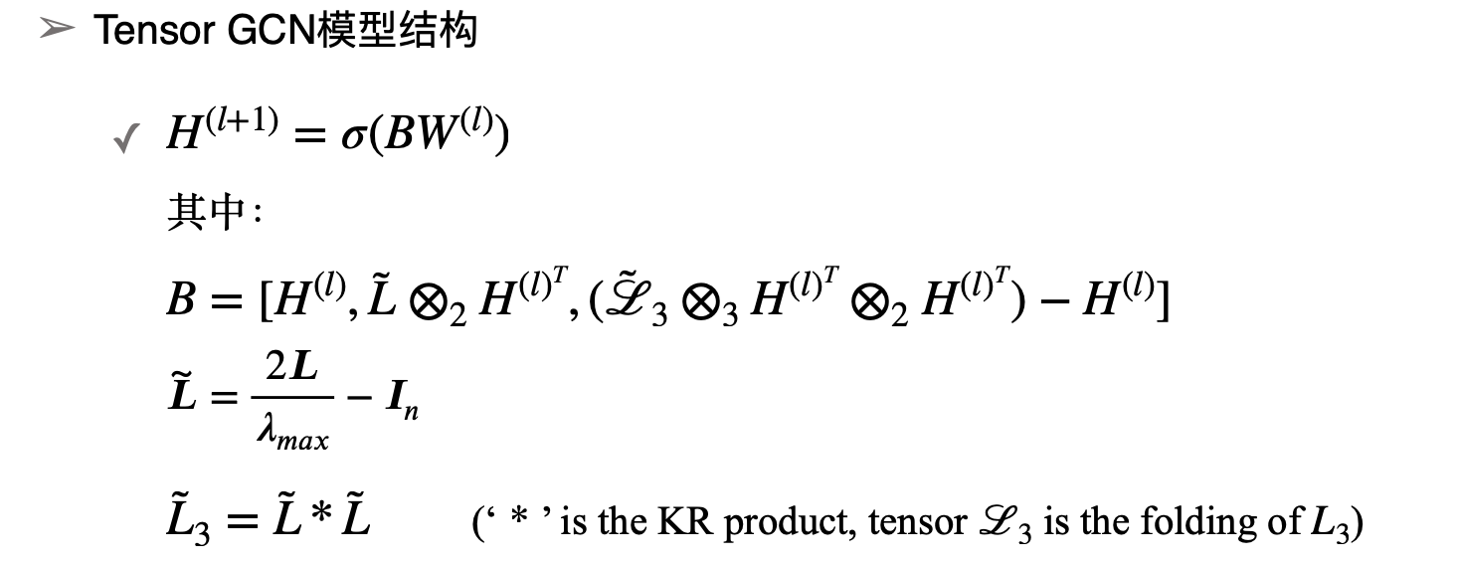
张量化图卷积实现
Notes:
Someone may want to ask what salient object detection means and how to define the salient object. The saliency detection is to find clear foreground objects that are significantly different from the surrounding background in the image. The differences can be reflected in the color, texture and object shape. Let‘s see the first row in the figure. The input of the salient object detection is a digitized image and the output is a saliency probability map as in the second row. Each pixel of the input image has a calculated probability value in the probability map. The probability value is bigger, the probability is
higher that the pixel belongs to the salient object. Otherwise , if the probability value is small, it indicates a higher probability that the pixel belongs to the background. Generally, in the practical application, we apply a constant value in the probability map to separate the salient object from the input image. Just like the third row in the figure. Salient object detection can be used in many fields, like visual tracking, video matting and robot navigation.

Slide 3
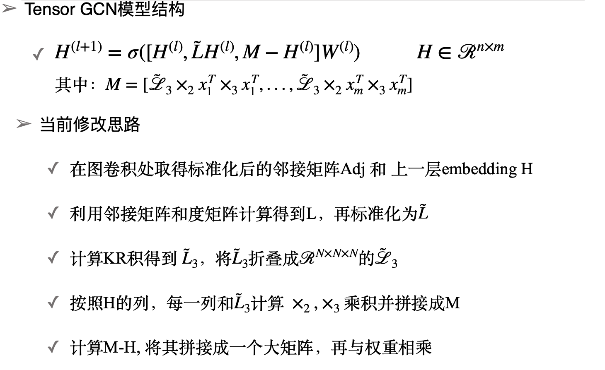
张量化图卷积实现

Slide 4
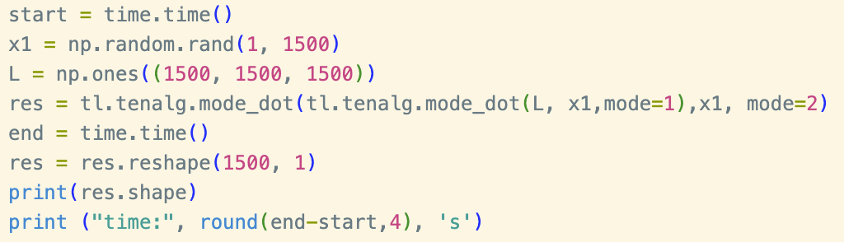
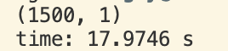
张量化图卷积问题
张量的空间复杂度高，大张量的存储困难
分列的mode-k product 效率低，可操作性差
需要时间:
Notes:
Someone may want to ask what salient object detection means and how to define the salient object. The saliency detection is to find clear foreground objects that are significantly different from the surrounding background in the image. The differences can be reflected in the color, texture and object shape. Let‘s see the first row in the figure. The input of the salient object detection is a digitized image and the output is a saliency probability map as in the second row. Each pixel of the input image has a calculated probability value in the probability map. The probability value is bigger, the probability is
higher that the pixel belongs to the salient object. Otherwise , if the probability value is small, it indicates a higher probability that the pixel belongs to the background. Generally, in the practical application, we apply a constant value in the probability map to separate the salient object from the input image. Just like the third row in the figure. Salient object detection can be used in many fields, like visual tracking, video matting and robot navigation.

Slide 5
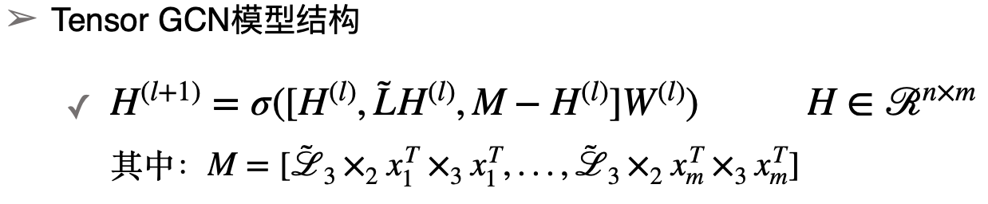
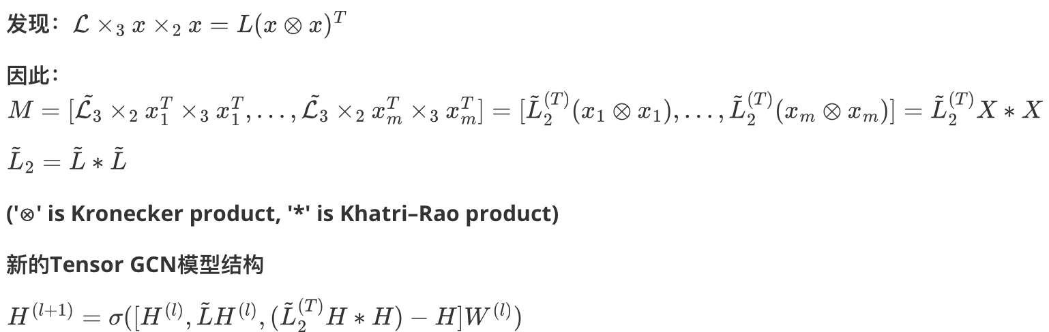
张量化图卷积改进思路
改进方案：
Notes:
Someone may want to ask what salient object detection means and how to define the salient object. The saliency detection is to find clear foreground objects that are significantly different from the surrounding background in the image. The differences can be reflected in the color, texture and object shape. Let‘s see the first row in the figure. The input of the salient object detection is a digitized image and the output is a saliency probability map as in the second row. Each pixel of the input image has a calculated probability value in the probability map. The probability value is bigger, the probability is
higher that the pixel belongs to the salient object. Otherwise , if the probability value is small, it indicates a higher probability that the pixel belongs to the background. Generally, in the practical application, we apply a constant value in the probability map to separate the salient object from the input image. Just like the third row in the figure. Salient object detection can be used in many fields, like visual tracking, video matting and robot navigation.

Slide 6
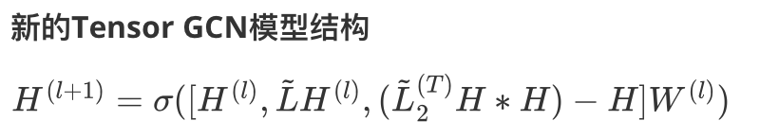
张量化图卷积改进思路
正在解决：
速度改进，目前一个epoch的时间约1600s
权重矩阵相比原来扩列了三倍，模型收敛慢
原版gcn依赖dropout，需要调参
是否可以尝试把三阶相似度换成不可分解的相似度
Notes:
Someone may want to ask what salient object detection means and how to define the salient object. The saliency detection is to find clear foreground objects that are significantly different from the surrounding background in the image. The differences can be reflected in the color, texture and object shape. Let‘s see the first row in the figure. The input of the salient object detection is a digitized image and the output is a saliency probability map as in the second row. Each pixel of the input image has a calculated probability value in the probability map. The probability value is bigger, the probability is
higher that the pixel belongs to the salient object. Otherwise , if the probability value is small, it indicates a higher probability that the pixel belongs to the background. Generally, in the practical application, we apply a constant value in the probability map to separate the salient object from the input image. Just like the third row in the figure. Salient object detection can be used in many fields, like visual tracking, video matting and robot navigation.

Slide 7
Notes:
Someone may want to ask what salient object detection means and how to define the salient object. The saliency detection is to find clear foreground objects that are significantly different from the surrounding background in the image. The differences can be reflected in the color, texture and object shape. Let‘s see the first row in the figure. The input of the salient object detection is a digitized image and the output is a saliency probability map as in the second row. Each pixel of the input image has a calculated probability value in the probability map. The probability value is bigger, the probability is
higher that the pixel belongs to the salient object. Otherwise , if the probability value is small, it indicates a higher probability that the pixel belongs to the background. Generally, in the practical application, we apply a constant value in the probability map to separate the salient object from the input image. Just like the third row in the figure. Salient object detection can be used in many fields, like visual tracking, video matting and robot navigation.

Slide 8
张量化图卷积改进思路
改进方案：
Notes:
Someone may want to ask what salient object detection means and how to define the salient object. The saliency detection is to find clear foreground objects that are significantly different from the surrounding background in the image. The differences can be reflected in the color, texture and object shape. Let‘s see the first row in the figure. The input of the salient object detection is a digitized image and the output is a saliency probability map as in the second row. Each pixel of the input image has a calculated probability value in the probability map. The probability value is bigger, the probability is
higher that the pixel belongs to the salient object. Otherwise , if the probability value is small, it indicates a higher probability that the pixel belongs to the background. Generally, in the practical application, we apply a constant value in the probability map to separate the salient object from the input image. Just like the third row in the figure. Salient object detection can be used in many fields, like visual tracking, video matting and robot navigation.

Slide 9
张量化图卷积改进思路
正在解决：
速度改进
权重矩阵相比原来扩列了三倍，模型收敛慢
原版gcn依赖dropout，需要调参
是否可以尝试把三阶相似度换成不可分解的相似度
Notes:
Someone may want to ask what salient object detection means and how to define the salient object. The saliency detection is to find clear foreground objects that are significantly different from the surrounding background in the image. The differences can be reflected in the color, texture and object shape. Let‘s see the first row in the figure. The input of the salient object detection is a digitized image and the output is a saliency probability map as in the second row. Each pixel of the input image has a calculated probability value in the probability map. The probability value is bigger, the probability is
higher that the pixel belongs to the salient object. Otherwise , if the probability value is small, it indicates a higher probability that the pixel belongs to the background. Generally, in the practical application, we apply a constant value in the probability map to separate the salient object from the input image. Just like the third row in the figure. Salient object detection can be used in many fields, like visual tracking, video matting and robot navigation.

Slide 10
张量化图卷积改进方案
解决方案：
速度改进：把L2行分块，提前计算H*H (L2的重复计算问题)
减小学习率, dropout 仍然设置为0.5
实验结果：
一层张量GCN，100代左右收敛，最终loss 0.007， Acc 62.5%
train acc很快达到了100，后续的训练缺乏效果
Notes:
Someone may want to ask what salient object detection means and how to define the salient object. The saliency detection is to find clear foreground objects that are significantly different from the surrounding background in the image. The differences can be reflected in the color, texture and object shape. Let‘s see the first row in the figure. The input of the salient object detection is a digitized image and the output is a saliency probability map as in the second row. Each pixel of the input image has a calculated probability value in the probability map. The probability value is bigger, the probability is
higher that the pixel belongs to the salient object. Otherwise , if the probability value is small, it indicates a higher probability that the pixel belongs to the background. Generally, in the practical application, we apply a constant value in the probability map to separate the salient object from the input image. Just like the third row in the figure. Salient object detection can be used in many fields, like visual tracking, video matting and robot navigation.

Slide 11
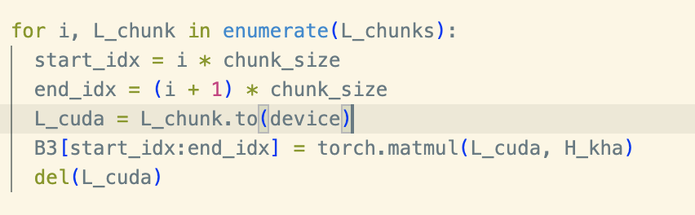
张量化图卷积改进思路
正在解决：
两层张量GCN的显存bug
引入不可分解相似度
Notes:
Someone may want to ask what salient object detection means and how to define the salient object. The saliency detection is to find clear foreground objects that are significantly different from the surrounding background in the image. The differences can be reflected in the color, texture and object shape. Let‘s see the first row in the figure. The input of the salient object detection is a digitized image and the output is a saliency probability map as in the second row. Each pixel of the input image has a calculated probability value in the probability map. The probability value is bigger, the probability is
higher that the pixel belongs to the salient object. Otherwise , if the probability value is small, it indicates a higher probability that the pixel belongs to the background. Generally, in the practical application, we apply a constant value in the probability map to separate the salient object from the input image. Just like the third row in the figure. Salient object detection can be used in many fields, like visual tracking, video matting and robot navigation.

Slide 12
Notes:
Someone may want to ask what salient object detection means and how to define the salient object. The saliency detection is to find clear foreground objects that are significantly different from the surrounding background in the image. The differences can be reflected in the color, texture and object shape. Let‘s see the first row in the figure. The input of the salient object detection is a digitized image and the output is a saliency probability map as in the second row. Each pixel of the input image has a calculated probability value in the probability map. The probability value is bigger, the probability is
higher that the pixel belongs to the salient object. Otherwise , if the probability value is small, it indicates a higher probability that the pixel belongs to the background. Generally, in the practical application, we apply a constant value in the probability map to separate the salient object from the input image. Just like the third row in the figure. Salient object detection can be used in many fields, like visual tracking, video matting and robot navigation.

Slide 13
张量化图卷积改进思路
改进方案：
Notes:
Someone may want to ask what salient object detection means and how to define the salient object. The saliency detection is to find clear foreground objects that are significantly different from the surrounding background in the image. The differences can be reflected in the color, texture and object shape. Let‘s see the first row in the figure. The input of the salient object detection is a digitized image and the output is a saliency probability map as in the second row. Each pixel of the input image has a calculated probability value in the probability map. The probability value is bigger, the probability is
higher that the pixel belongs to the salient object. Otherwise , if the probability value is small, it indicates a higher probability that the pixel belongs to the background. Generally, in the practical application, we apply a constant value in the probability map to separate the salient object from the input image. Just like the third row in the figure. Salient object detection can be used in many fields, like visual tracking, video matting and robot navigation.

Slide 14
张量化图卷积改进思路
当下问题：
两层张量GCN的显存无限申请bug(无法解决)
重写代码逻辑
Notes:
Someone may want to ask what salient object detection means and how to define the salient object. The saliency detection is to find clear foreground objects that are significantly different from the surrounding background in the image. The differences can be reflected in the color, texture and object shape. Let‘s see the first row in the figure. The input of the salient object detection is a digitized image and the output is a saliency probability map as in the second row. Each pixel of the input image has a calculated probability value in the probability map. The probability value is bigger, the probability is
higher that the pixel belongs to the salient object. Otherwise , if the probability value is small, it indicates a higher probability that the pixel belongs to the background. Generally, in the practical application, we apply a constant value in the probability map to separate the salient object from the input image. Just like the third row in the figure. Salient object detection can be used in many fields, like visual tracking, video matting and robot navigation.

Slide 15
张量化图卷积实验结果(未引入不可分解相似度)
关键参数
学习率
dropout
权重衰减
中间层维度(hidden dimension)
Notes:
Someone may want to ask what salient object detection means and how to define the salient object. The saliency detection is to find clear foreground objects that are significantly different from the surrounding background in the image. The differences can be reflected in the color, texture and object shape. Let‘s see the first row in the figure. The input of the salient object detection is a digitized image and the output is a saliency probability map as in the second row. Each pixel of the input image has a calculated probability value in the probability map. The probability value is bigger, the probability is
higher that the pixel belongs to the salient object. Otherwise , if the probability value is small, it indicates a higher probability that the pixel belongs to the background. Generally, in the practical application, we apply a constant value in the probability map to separate the salient object from the input image. Just like the third row in the figure. Salient object detection can be used in many fields, like visual tracking, video matting and robot navigation.

Slide 16
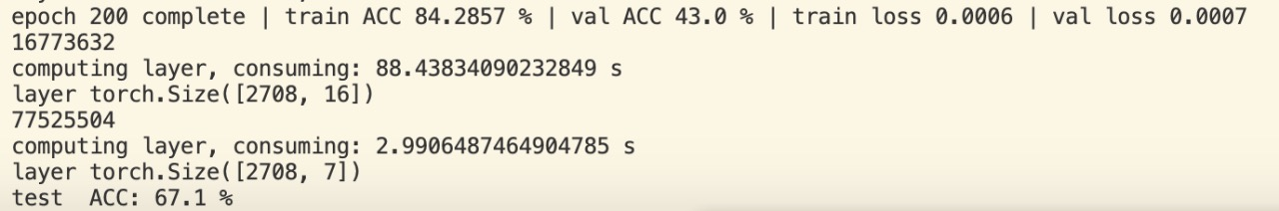
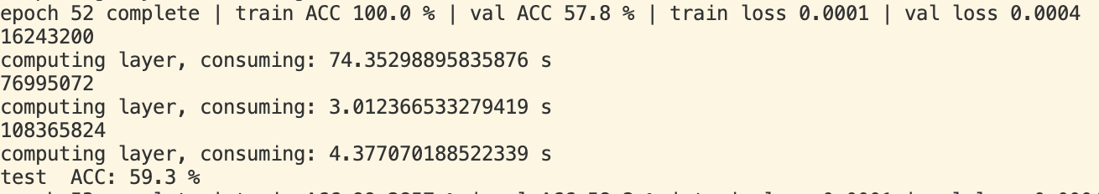
张量化图卷积实验结果(未引入不可分解相似度)
单层
两层
三层
Notes:
Someone may want to ask what salient object detection means and how to define the salient object. The saliency detection is to find clear foreground objects that are significantly different from the surrounding background in the image. The differences can be reflected in the color, texture and object shape. Let‘s see the first row in the figure. The input of the salient object detection is a digitized image and the output is a saliency probability map as in the second row. Each pixel of the input image has a calculated probability value in the probability map. The probability value is bigger, the probability is
higher that the pixel belongs to the salient object. Otherwise , if the probability value is small, it indicates a higher probability that the pixel belongs to the background. Generally, in the practical application, we apply a constant value in the probability map to separate the salient object from the input image. Just like the third row in the figure. Salient object detection can be used in many fields, like visual tracking, video matting and robot navigation.

Slide 17
张量化图卷积
正在解决：
继续对张量GCN调参
使用其他的citation network实验
引入不可分解相似度
结合《Multi-View Spectral Clustering with High-Order Optimal Neighborhood Laplacian Matrix》
Notes:
Someone may want to ask what salient object detection means and how to define the salient object. The saliency detection is to find clear foreground objects that are significantly different from the surrounding background in the image. The differences can be reflected in the color, texture and object shape. Let‘s see the first row in the figure. The input of the salient object detection is a digitized image and the output is a saliency probability map as in the second row. Each pixel of the input image has a calculated probability value in the probability map. The probability value is bigger, the probability is
higher that the pixel belongs to the salient object. Otherwise , if the probability value is small, it indicates a higher probability that the pixel belongs to the background. Generally, in the practical application, we apply a constant value in the probability map to separate the salient object from the input image. Just like the third row in the figure. Salient object detection can be used in many fields, like visual tracking, video matting and robot navigation.

Slide 18
Multi-View Spectral Clustering with High-Order Optimal Neighborhood Laplacian Matrix
王朝颐
华南理工大学生物信息实验室
2023年5月6日
Notes:
Good evening, everyone! My name is daigang. Today, I’ll introduce the paper named“&*&#@$%”, it focus on salient object detection, and was published in CVPR 2019.

Slide 19
可分解相似度张量GCN结论
单层
两层
三层
Notes:
Someone may want to ask what salient object detection means and how to define the salient object. The saliency detection is to find clear foreground objects that are significantly different from the surrounding background in the image. The differences can be reflected in the color, texture and object shape. Let‘s see the first row in the figure. The input of the salient object detection is a digitized image and the output is a saliency probability map as in the second row. Each pixel of the input image has a calculated probability value in the probability map. The probability value is bigger, the probability is
higher that the pixel belongs to the salient object. Otherwise , if the probability value is small, it indicates a higher probability that the pixel belongs to the background. Generally, in the practical application, we apply a constant value in the probability map to separate the salient object from the input image. Just like the third row in the figure. Salient object detection can be used in many fields, like visual tracking, video matting and robot navigation.

Slide 20
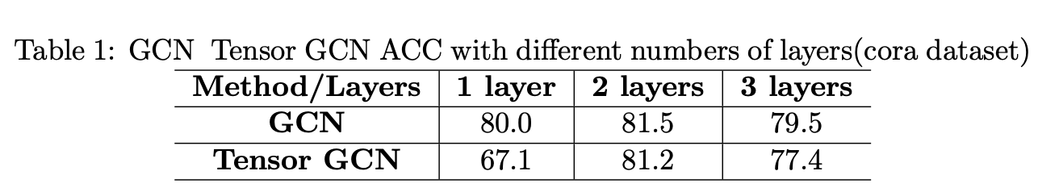
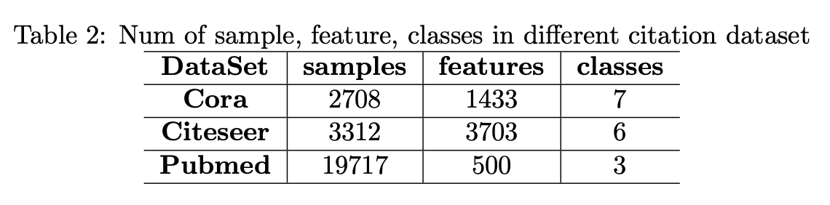
当前处理关键问题
张量GCN当前问题
基于可分解相似度构建高阶拉普拉斯同原版GCN近似
适用于citation-network的不可分解高阶相似度定义方式
在当前相似度定义下，除cora外的数据集样本数太多，无法存放
Notes:
And then I will show some saliency results based on the traditional methods. We can see the figure. The first column is input images , and other columns are results processed by different traditional methods. We can see the results are not good, for example, the first row, the results are blurred and couldn’t precisely locate the flower.so why traditional methods performs so bad on salient object detection?. Because traditional methods mostly rely on hand-crafted features to capture local details and global context , the ability of hand-crafted features capturing high-level semantic information is too weak to detect the integral salient objects in complex scenes.

Slide 21
多视图谱聚类
多视图谱聚类常见的三种方法(按照融合方式划分)：
强制不同视图的结果相同(协同训练)
每个视图的相似度矩阵是最优相似度矩阵的微扰
最优拉普拉斯是基本拉普拉斯的线性聚合
三类方法的共同问题：
默认最优拉普拉斯位于由基本拉普拉斯构成的线性空间里
作者提出的方案：
将最优拉普拉斯的可行范围扩展到一阶和高阶拉普拉斯矩阵的
线性组合的邻域内 「统一不同阶和不同视图」
Notes:
And then I will show some saliency results based on the traditional methods. We can see the figure. The first column is input images , and other columns are results processed by different traditional methods. We can see the results are not good, for example, the first row, the results are blurred and couldn’t precisely locate the flower.so why traditional methods performs so bad on salient object detection?. Because traditional methods mostly rely on hand-crafted features to capture local details and global context , the ability of hand-crafted features capturing high-level semantic information is too weak to detect the integral salient objects in complex scenes.

Slide 22
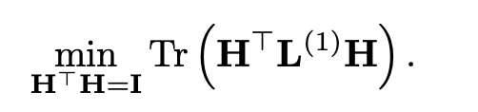
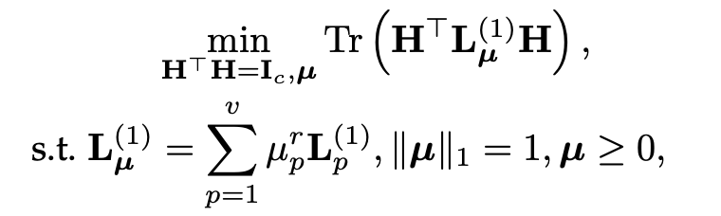
多视图谱聚类与拉普拉斯
多视图拉普拉斯
传统谱聚类目标：
多视图谱聚类：
其中µ为权重参数，L_µ为当前阶相似度下的最优拉普拉斯，r为超参
Notes:
And then I will show some saliency results based on the traditional methods. We can see the figure. The first column is input images , and other columns are results processed by different traditional methods. We can see the results are not good, for example, the first row, the results are blurred and couldn’t precisely locate the flower.so why traditional methods performs so bad on salient object detection?. Because traditional methods mostly rely on hand-crafted features to capture local details and global context , the ability of hand-crafted features capturing high-level semantic information is too weak to detect the integral salient objects in complex scenes.

Slide 23
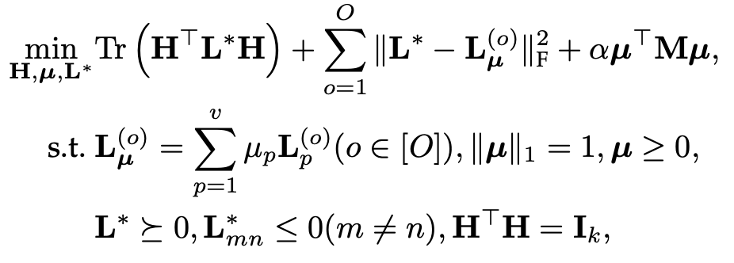
Optimal Neighborhood Multi-view Spectral Clustering (ONMSC)
ONMSC
L*为最优拉普拉斯，L_µ是第0阶下多视图融合得来的拉普拉斯
M是一种针对多视图聚类的相关性测量矩阵，在单一视图下为常量
由于解决此问题的困难性，作者做了改写(替换拉普拉斯)
Notes:
And then I will show some saliency results based on the traditional methods. We can see the figure. The first column is input images , and other columns are results processed by different traditional methods. We can see the results are not good, for example, the first row, the results are blurred and couldn’t precisely locate the flower.so why traditional methods performs so bad on salient object detection?. Because traditional methods mostly rely on hand-crafted features to capture local details and global context , the ability of hand-crafted features capturing high-level semantic information is too weak to detect the integral salient objects in complex scenes.

Slide 24
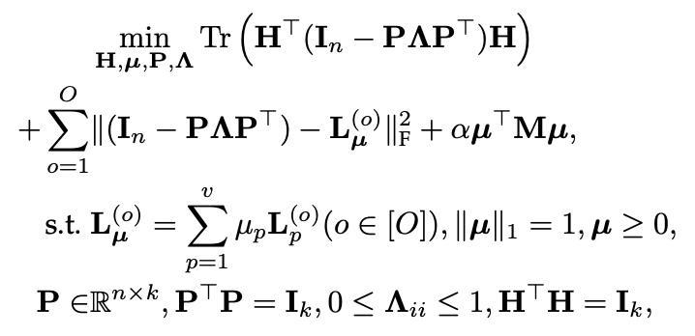
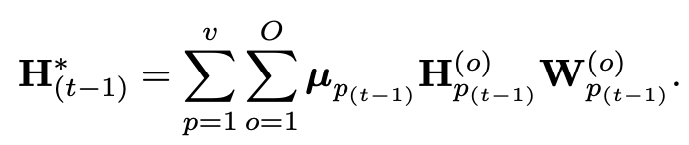
Optimal Neighborhood Multi-view Spectral Clustering (ONMSC)
ONMSC
模型：
Notes:
And then I will show some saliency results based on the traditional methods. We can see the figure. The first column is input images , and other columns are results processed by different traditional methods. We can see the results are not good, for example, the first row, the results are blurred and couldn’t precisely locate the flower.so why traditional methods performs so bad on salient object detection?. Because traditional methods mostly rely on hand-crafted features to capture local details and global context , the ability of hand-crafted features capturing high-level semantic information is too weak to detect the integral salient objects in complex scenes.

Slide 25
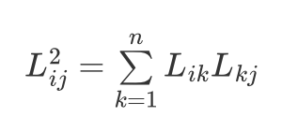
Optimal Neighborhood Multi-view Spectral Clustering (ONMSC)
ONMSC的不可分解拉普拉斯构建
找到i, j的公共邻居k, 统计相似度之和
优势：不可分解的相似度，且高阶的拉普拉斯仍然为nxn
难点：样本多，计算时的搜索空间很大，需要统计i, j的所有公共邻居
Notes:
And then I will show some saliency results based on the traditional methods. We can see the figure. The first column is input images , and other columns are results processed by different traditional methods. We can see the results are not good, for example, the first row, the results are blurred and couldn’t precisely locate the flower.so why traditional methods performs so bad on salient object detection?. Because traditional methods mostly rely on hand-crafted features to capture local details and global context , the ability of hand-crafted features capturing high-level semantic information is too weak to detect the integral salient objects in complex scenes.

Slide 26
张量GCN
王朝颐
华南理工大学生物信息实验室
2023年6月29日

Slide 27
汇报大纲
张量GCN构建回顾
实验结果
张量GCN修改

Slide 28
张量化图卷积实现
Notes:
* 张量GCN最开始是基于GCN的迭代公式直接做替换
* 下一层的embedding定义为一个由多个不同阶相似度信息拼起来的大矩阵和权重的乘积
* 高阶信息的矩阵就是M，这里得到M的方式是通过展列H，并让高阶拉普拉斯和每列做两次mode-k乘积

Slide 29
张量化图卷积改进思路
改进方案：
Notes:
这种方法是直观的，但时间复杂度太高了，
然后我们发现mode-k的连乘可以转化为克劳内克乘积，同时列展开的公式也可以用katri-rao乘积的定义做化简，最终化简后就得到了一个 计算上是通过katri-rao乘积实现高阶嵌入的迭代

Slide 30

张量GCN实验结果
张量GCN的结果和原版GCN类似
基于ONMSC的拉普拉斯
Notes:
调参之后，我们发现张量GCN在不同的数据集下都可以和原版GCN打平，那么就需要寻找一种其他的定义方式来做。
我引入了ONMSC的这种定义方式，它找到ij的公共邻居k，统计相似度之和，这种方法的好处就是高阶拉普拉斯的复杂度降低了，因此速度和原版GCN几乎一样，并且可以在更大的数据集上测试，我简单的调整参数测试了一下，仍然是和原版GCN保持了一个比较接近的水平，那么这种方法上限可能也就这样了。

Slide 31
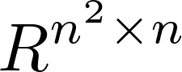
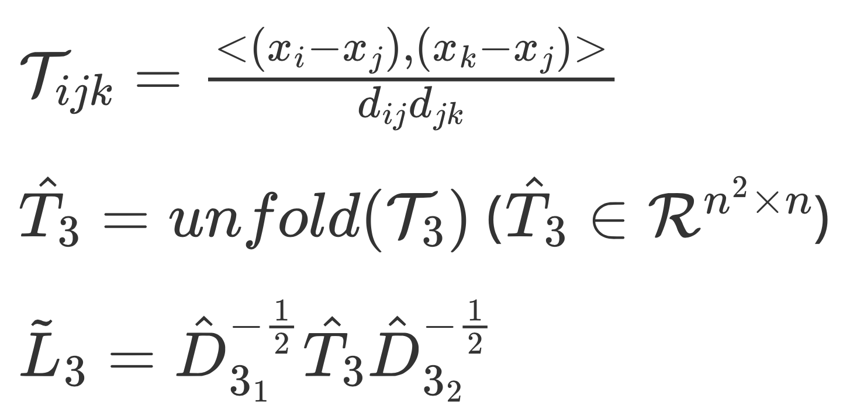
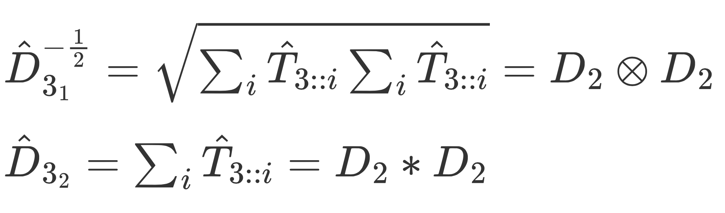
基于 的不可分解张量相似度
不可分解相似度：
其中：
体外计算并保存，训练时只引入最后的拉普拉斯
Notes:
接下来按照要求我们仍然要基于 n^2 x n 这个大小来构建不可分解相似度，这里就引入UTC里面的这种三阶相似度定义方式，对于这样的一个相似度 T_ijk而言，它对应了 在 x_j视角下 x_i和x_k间的相似度，如果x_i和x_k的距离很近，那么无论x_j处于什么位置，T_ijk都应该是一个不大的值
然后在标准化的时候两边不对称，一边是克劳内克一边是katri rao，我试着先提前按照数据集不同计算出L然后训练的时候引入就行。

Slide 32
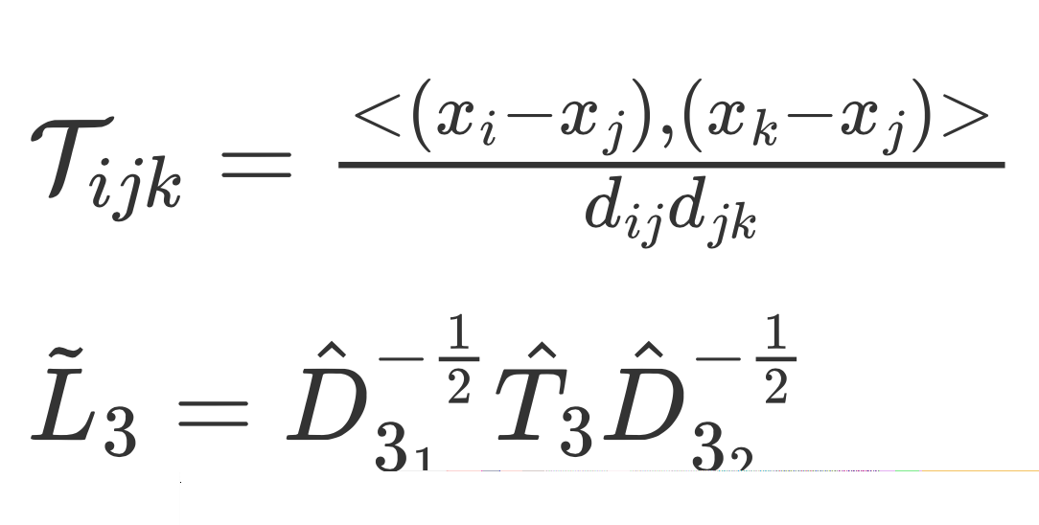
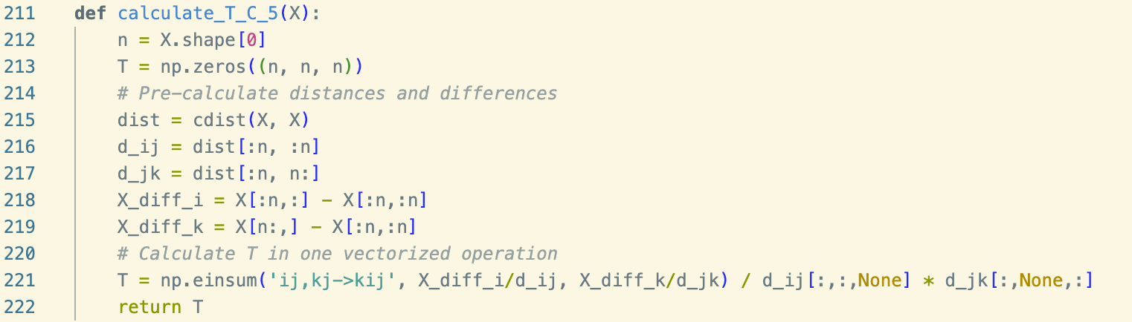
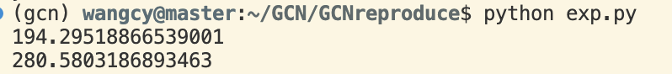
基于 的不可分解张量相似度实现
当前问题：
样本量大，T的计算耗时太久 「下为数据集1/10生成时间」
Notes:
然后我这边先写了一个小样，发现这样的张量 它由于不是稀疏的 需要逐点计算，所以时间复杂度太高了
取2700个样本中的270个来计算T 需要花掉200多秒，扩大十倍的话，因为n^3，时间会变成原来的1000倍，
做到这里的话，本来是想说 我们能不能试着去少计算一些T_ijk 使得这个张量稀疏化， 比较直观的方式就是通过快速KNN来快速筛选出 影响最大的ijk组， 这时候对于i来说，只有他的两个近邻需要计算相似度，其他的则不计算相似度。
然后我发现这种做法它其实硬伤还不在张量的实现，而是标准化时候用的度矩阵做不了，其中D31，因为它是由原来的度矩阵执行kronecker得来的， 所以它的shape为,2708的平方*2708的平方， 也就是一个700w * 700w的矩阵，所以感觉问题还是在于样本数量太大了

Slide 33
当前处理关键问题
张量GCN当前瓶颈
基于 拉普拉斯的高阶相似度在ciation-network数据集背景下难以实现
其他实现方式在citation-network数据集下与原版GCN接近
Notes:
GCN 使用的citation network 它是一种引用网络，自带图结构，所以它确实是适合GCN的应用，但是引用网络的节点数量太多，这导致拉普拉斯复杂度的大幅上升，即使可以体外计算也难以实现
然后目前尝试过的几种构建方式 都和原版GCN拉不开差距

Slide 34
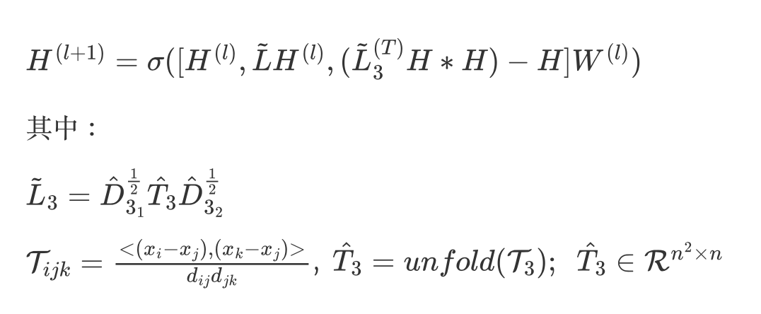
解决方案
使用高维小样本数据集，使用高斯核函数人工形成图结构
得到相似度矩阵后，用阈值筛选S_ij来构建边集
对比GCN和张量GCN在高维小样本数据集图上的表现
模型结构：

Slide 35
小样本张量GCN
王朝颐
华南理工大学生物信息实验室
2023年7月15日

Slide 36
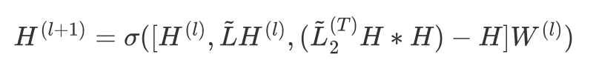
当前处理问题
使用高维小样本数据集，使用高斯核函数人工形成图结构
得到相似度矩阵后，用阈值筛选S_ij来构建边集
对比GCN和张量GCN在高维小样本数据集图上的表现
模型结构：

Slide 37
小样本建图训练实现方法
导入Matlab数据集，将标签转化为one-hot格式
按照数据比例划分训练集和测试集
根据label生成训练和测试使用的mask
计算样本相似度，获取相似度矩阵S
进行距离排序，每个样本选取离其最近的6个样本作为邻居
根据样本与邻居的相似度构建邻接矩阵
将邻接矩阵、mask、特征和标签输入模型训练

Slide 38
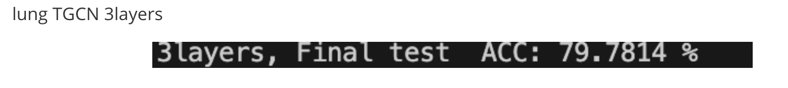
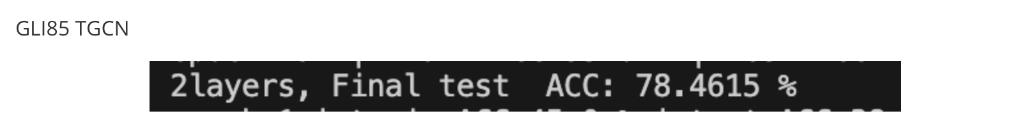
小样本张量GCN实验结果
Lung
GLI 85
Notes:
调参之后，我们发现张量GCN在不同的数据集下都可以和原版GCN打平，那么就需要寻找一种其他的定义方式来做。
我引入了ONMSC的这种定义方式，它找到ij的公共邻居k，统计相似度之和，这种方法的好处就是高阶拉普拉斯的复杂度降低了，因此速度和原版GCN几乎一样，并且可以在更大的数据集上测试，我简单的调整参数测试了一下，仍然是和原版GCN保持了一个比较接近的水平，那么这种方法上限可能也就这样了。

Slide 39
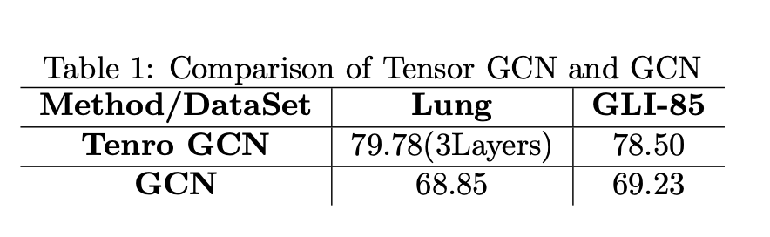
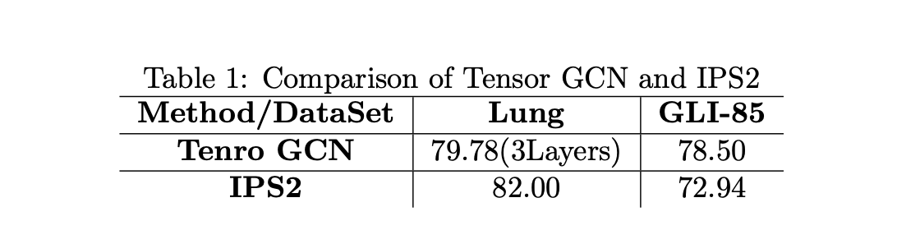
小样本张量GCN实验结果
与GCN在小样本数据集下的比较
(GCN在高层时的ACC会提升)
与其他小样本算法(聚类)：
在Lung上的表现略低于IPS2
在GLI-85上的表现好IPS2
Notes:
调参之后，我们发现张量GCN在不同的数据集下都可以和原版GCN打平，那么就需要寻找一种其他的定义方式来做。
我引入了ONMSC的这种定义方式，它找到ij的公共邻居k，统计相似度之和，这种方法的好处就是高阶拉普拉斯的复杂度降低了，因此速度和原版GCN几乎一样，并且可以在更大的数据集上测试，我简单的调整参数测试了一下，仍然是和原版GCN保持了一个比较接近的水平，那么这种方法上限可能也就这样了。

Slide 40
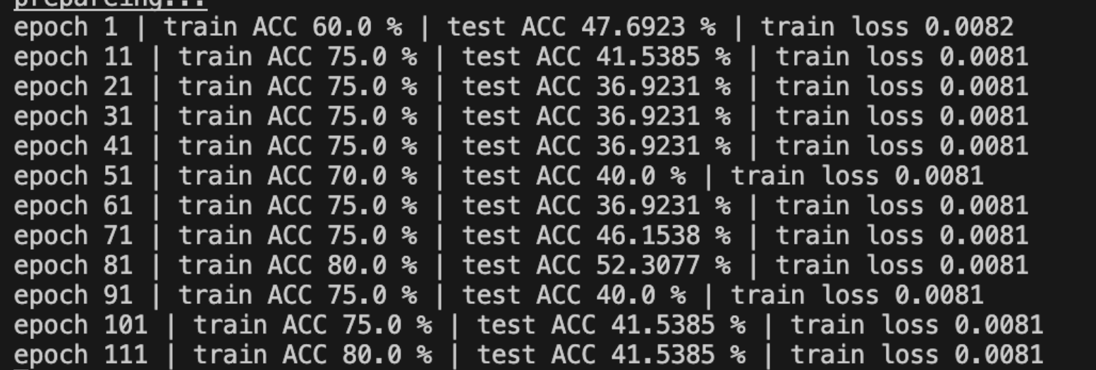
当前问题和解决方案
有时会出现训练无效果问题
只使用三阶相似度/更换小样本数据集建图方式
张量图卷积推导疑问

Slide 41
张量图卷积推导疑问
与GCN在小样本数据集下的比较
与其他小样本算法(聚类)：
在Lung上的表现略低于IPS2
在GLI-85上的表现好IPS2
Notes:
调参之后，我们发现张量GCN在不同的数据集下都可以和原版GCN打平，那么就需要寻找一种其他的定义方式来做。
我引入了ONMSC的这种定义方式，它找到ij的公共邻居k，统计相似度之和，这种方法的好处就是高阶拉普拉斯的复杂度降低了，因此速度和原版GCN几乎一样，并且可以在更大的数据集上测试，我简单的调整参数测试了一下，仍然是和原版GCN保持了一个比较接近的水平，那么这种方法上限可能也就这样了。

Slide 42
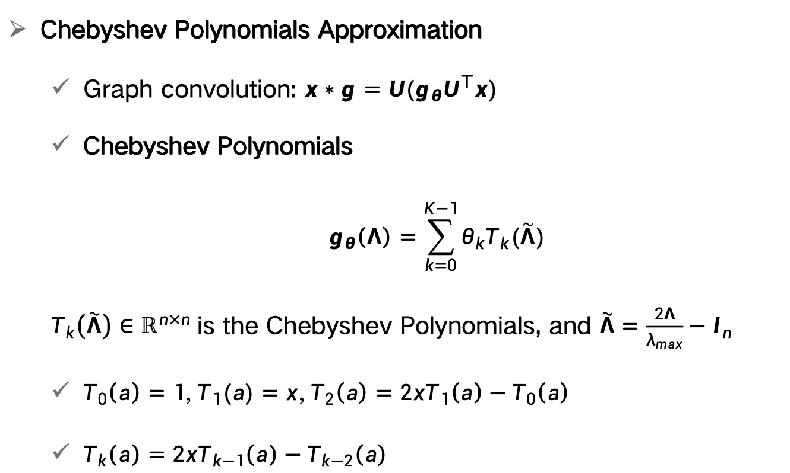
张量图卷积推导疑问
Chebyshev Polynomials Approximation
Graph convolution: $x∗g=U(g_{θ}U^{⊤}x)$
Chebyshev Polynomials
$$g_{θ}\left(Λ\right)=\sum_{k=0}^{K−1}{θ_{k}T_{k}(\tilde{Λ})}$$
$T_{k}\left(\tilde{Λ}\right)∈ℝ^{n×n}$ is the Chebyshev Polynomials, and $\tilde{Λ}=\frac{2Λ}{λ_{max}}−I_{n}$
$T_{0}\left(a\right)=1$, $T_{1}(a)=x$, $T_{2}\left(a\right)=2xT_{1}\left(a\right)−T_{0}\left(a\right)$
$T_{k}\left(a\right)=2xT_{k−1}\left(a\right)−T_{k−2}\left(a\right)$
Defferrard, Michaël, Xavier Bresson, and Pierre Vandergheynst. "Convolutional neural networks on graphs with fast localized spectral filtering." Advances in neural information processing systems 29 (2016).
Notes:
Someone may want to ask what salient object detection means and how to define the salient object. The saliency detection is to find clear foreground objects that are significantly different from the surrounding background in the image. The differences can be reflected in the color, texture and object shape. Let‘s see the first row in the figure. The input of the salient object detection is a digitized image and the output is a saliency probability map as in the second row. Each pixel of the input image has a calculated probability value in the probability map. The probability value is bigger, the probability is
higher that the pixel belongs to the salient object. Otherwise , if the probability value is small, it indicates a higher probability that the pixel belongs to the background. Generally, in the practical application, we apply a constant value in the probability map to separate the salient object from the input image. Just like the third row in the figure. Salient object detection can be used in many fields, like visual tracking, video matting and robot navigation.

Slide 43
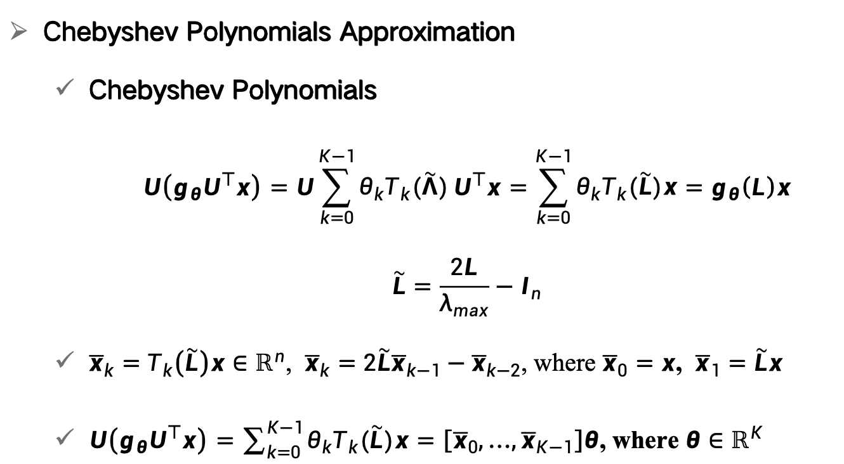
张量图卷积推导疑问
Chebyshev Polynomials Approximation
Chebyshev Polynomials
$$U\left(g_{θ}U^{⊤}x\right)=U\sum_{k=0}^{K−1}{θ_{k}T_{k}(\tilde{Λ})}U^{⊤}x=\sum_{k=0}^{K−1}{θ_{k}T_{k}(\tilde{L})x}=g_{θ}\left(L\right)x$$
$$\tilde{L}=\frac{2L}{λ_{max}}−I_{n}$$
${\overline{x}}_{k}=$ $T_{k}\left(\tilde{L}\right)x∈ℝ^{n}$, ${\overline{x}}_{k}=$ $2\tilde{L}{\overline{x}}_{k−1}−{\overline{x}}_{k−2}$, where ${\overline{x}}_{0}=x$, ${\overline{x}}_{1}=\tilde{L}x$
$U\left(g_{θ}U^{⊤}x\right)=\sum_{k=0}^{K−1}{θ_{k}T_{k}(\tilde{L})x}=\left[{\overline{x}}_{0},…,{\overline{x}}_{K−1}\right]θ$, where $θ∈ℝ^{K}$
Defferrard, Michaël, Xavier Bresson, and Pierre Vandergheynst. "Convolutional neural networks on graphs with fast localized spectral filtering." Advances in neural information processing systems 29 (2016).
Notes:
Someone may want to ask what salient object detection means and how to define the salient object. The saliency detection is to find clear foreground objects that are significantly different from the surrounding background in the image. The differences can be reflected in the color, texture and object shape. Let‘s see the first row in the figure. The input of the salient object detection is a digitized image and the output is a saliency probability map as in the second row. Each pixel of the input image has a calculated probability value in the probability map. The probability value is bigger, the probability is
higher that the pixel belongs to the salient object. Otherwise , if the probability value is small, it indicates a higher probability that the pixel belongs to the background. Generally, in the practical application, we apply a constant value in the probability map to separate the salient object from the input image. Just like the third row in the figure. Salient object detection can be used in many fields, like visual tracking, video matting and robot navigation.

Slide 44
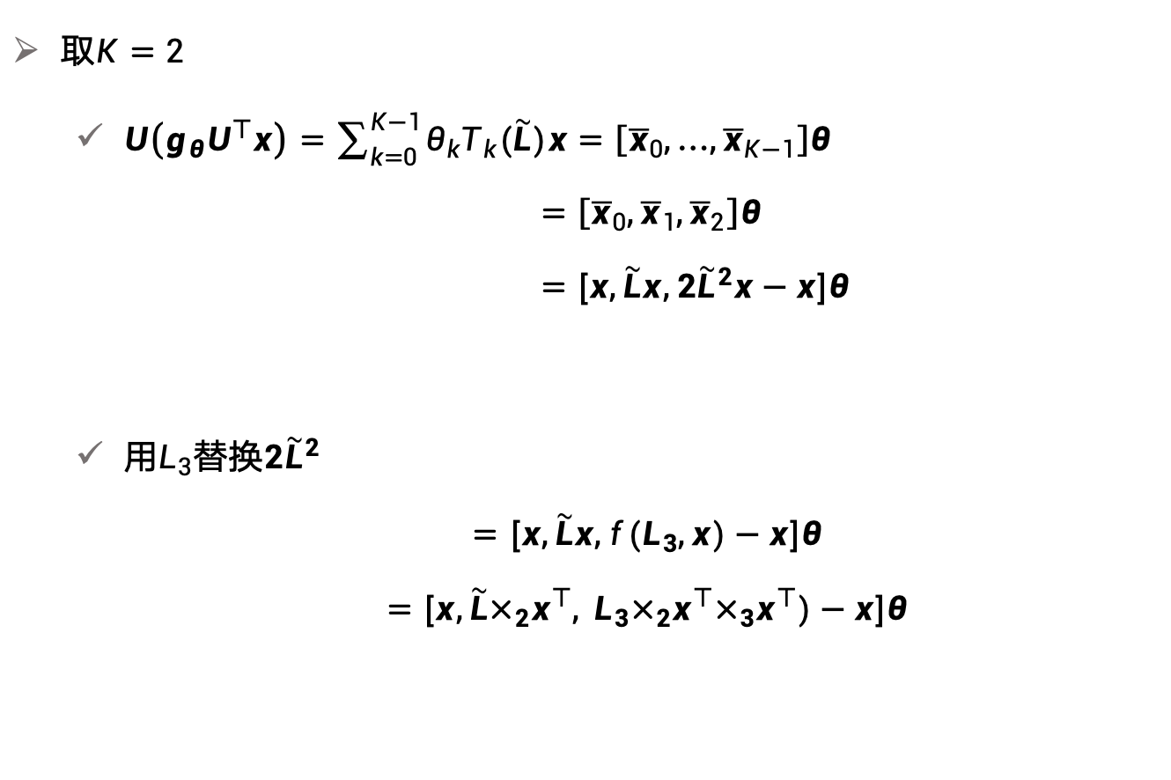
张量图卷积推导疑问
取$K=2$
$U\left(g_{θ}U^{⊤}x\right)=\sum_{k=0}^{K−1}{θ_{k}T_{k}(\tilde{L})x}=\left[{\overline{x}}_{0},…,{\overline{x}}_{K−1}\right]θ$ $=\left[{\overline{x}}_{0},{\overline{x}}_{1},{\overline{x}}_{2}\right]θ$ $=[x,\tilde{L}x,2{\tilde{L}}^{2}x−x]θ$
用$L_{3}$替换$2{\tilde{L}}^{2}$
$$=[x,\tilde{L}x,{f(L}_{3},x)−x]θ$$
$$=[x,\tilde{L}×_{2}x^{⊤},{ L}_{3}×_{2}x^{⊤}×_{3}x^{⊤})−x]θ$$
Defferrard, Michaël, Xavier Bresson, and Pierre Vandergheynst. "Convolutional neural networks on graphs with fast localized spectral filtering." Advances in neural information processing systems 29 (2016).
Notes:
Someone may want to ask what salient object detection means and how to define the salient object. The saliency detection is to find clear foreground objects that are significantly different from the surrounding background in the image. The differences can be reflected in the color, texture and object shape. Let‘s see the first row in the figure. The input of the salient object detection is a digitized image and the output is a saliency probability map as in the second row. Each pixel of the input image has a calculated probability value in the probability map. The probability value is bigger, the probability is
higher that the pixel belongs to the salient object. Otherwise , if the probability value is small, it indicates a higher probability that the pixel belongs to the background. Generally, in the practical application, we apply a constant value in the probability map to separate the salient object from the input image. Just like the third row in the figure. Salient object detection can be used in many fields, like visual tracking, video matting and robot navigation.

Slide 45
小样本张量GCN
王朝颐
华南理工大学生物信息实验室
2023年8月9日

Slide 46
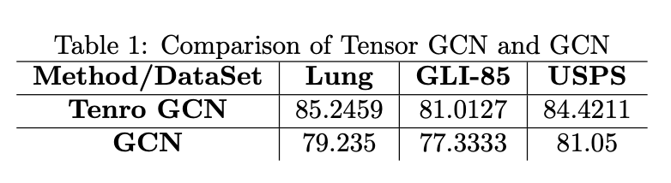
小样本张量GCN实验
张量GCN使用六近邻构图，和普通GCN采取一样的半监督样本划分
设置不同的中间层隐藏层维度(16～1024)
模型层数：1～10层
观察loss曲线，统计最高acc及其出现层数和各个层数的平均acc
实验结果

Slide 47
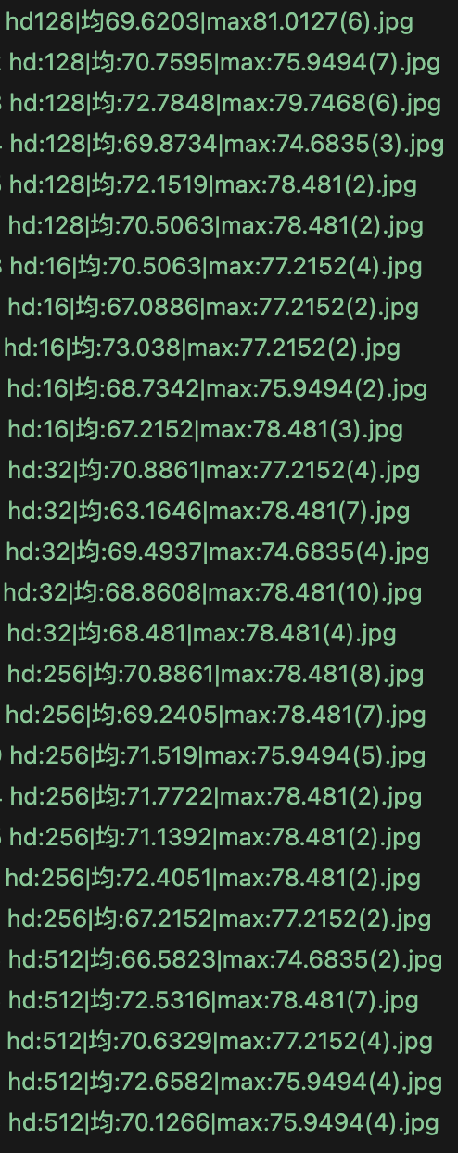
GLI-85实验结果
结果：
最高为81.0127(第六层)
多次训练的准确度几乎总会重复
并没有出现原版GCN的在3层及以上准确度明显下降的问题，层数曲线并无明显规律
Notes:
调参之后，我们发现张量GCN在不同的数据集下都可以和原版GCN打平，那么就需要寻找一种其他的定义方式来做。
我引入了ONMSC的这种定义方式，它找到ij的公共邻居k，统计相似度之和，这种方法的好处就是高阶拉普拉斯的复杂度降低了，因此速度和原版GCN几乎一样，并且可以在更大的数据集上测试，我简单的调整参数测试了一下，仍然是和原版GCN保持了一个比较接近的水平，那么这种方法上限可能也就这样了。

Slide 48
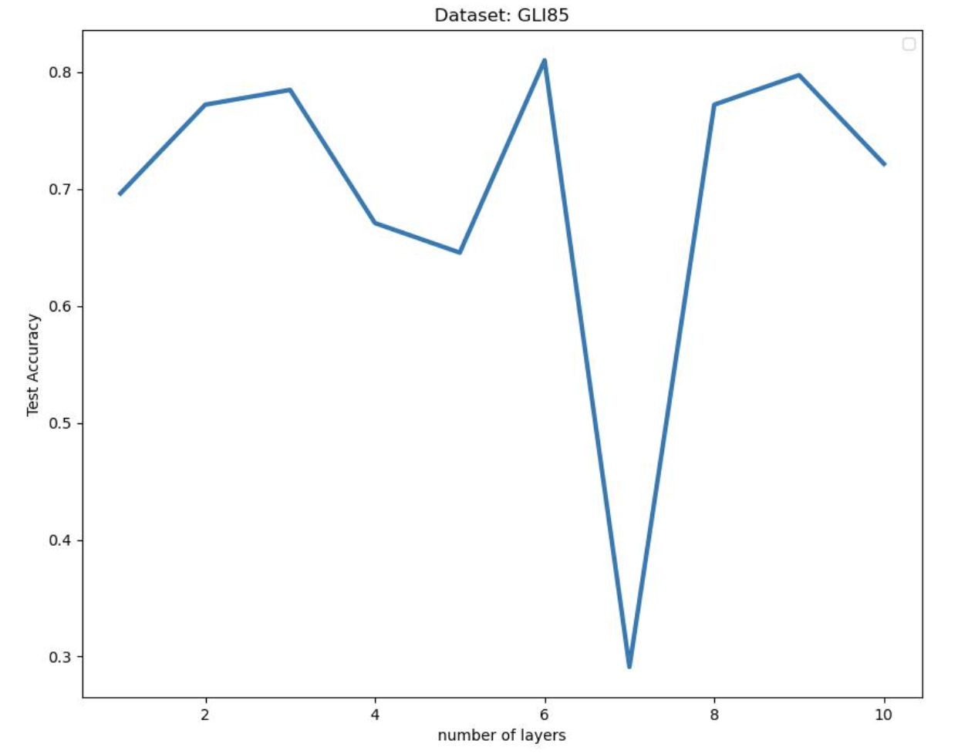
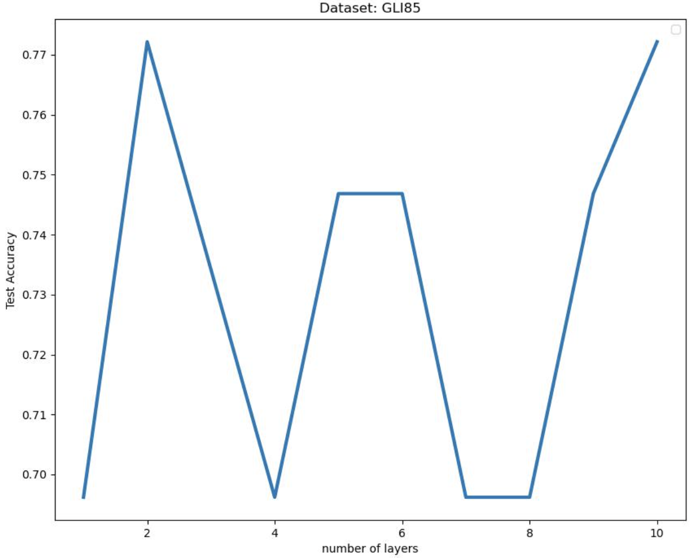
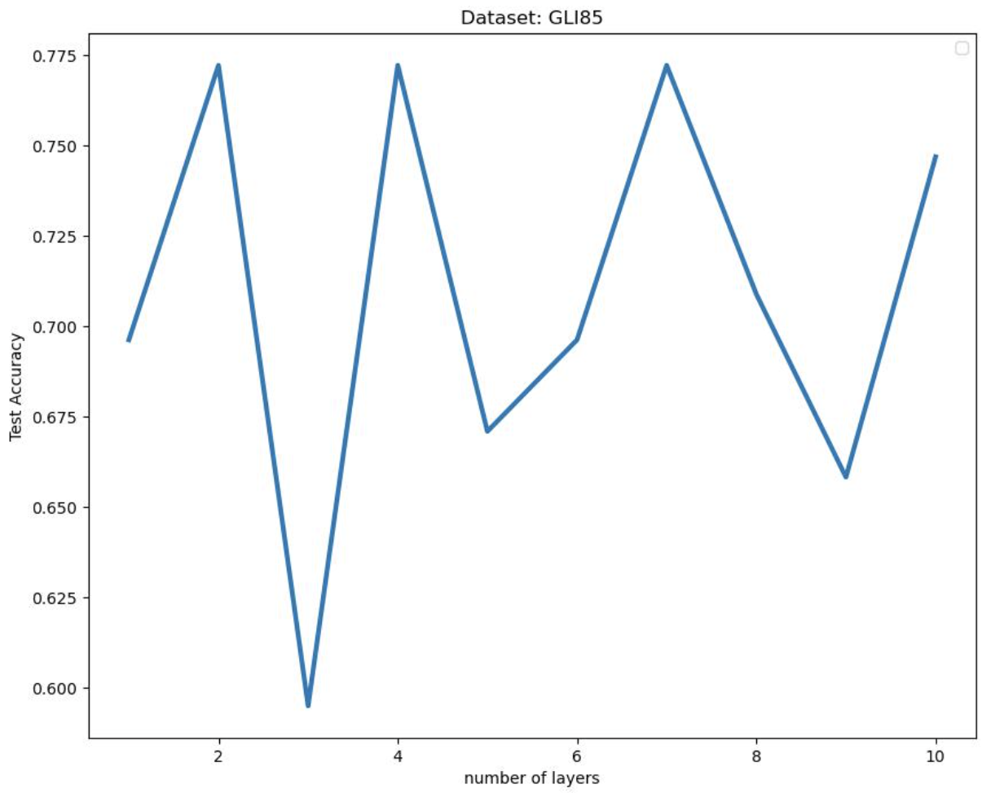
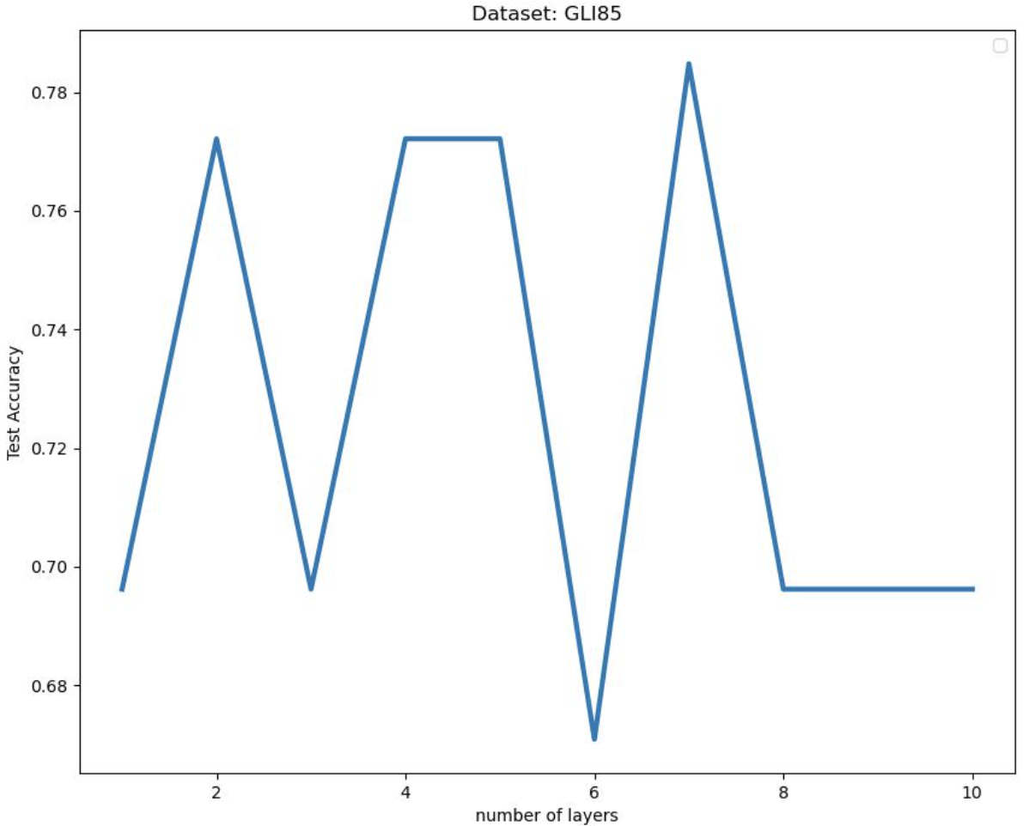
GLI-85层数曲线
Notes:
调参之后，我们发现张量GCN在不同的数据集下都可以和原版GCN打平，那么就需要寻找一种其他的定义方式来做。
我引入了ONMSC的这种定义方式，它找到ij的公共邻居k，统计相似度之和，这种方法的好处就是高阶拉普拉斯的复杂度降低了，因此速度和原版GCN几乎一样，并且可以在更大的数据集上测试，我简单的调整参数测试了一下，仍然是和原版GCN保持了一个比较接近的水平，那么这种方法上限可能也就这样了。

Slide 49
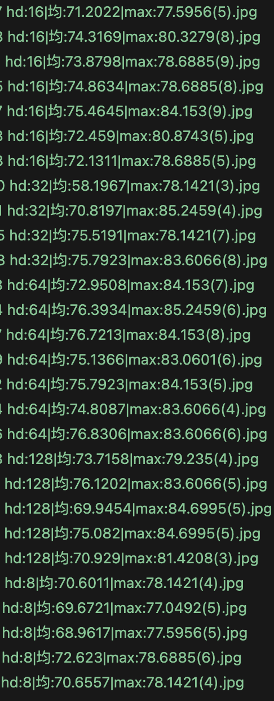
Lung实验结果
结果：
最高为85.2459(第四层)
多次训练的准确度几乎总会重复
并没有出现原版GCN的在3层及以上准确度明显下降的问题，层数曲线并无明显规律
推测：
隐藏层维度的增加会使得最优解在更早的层数到来
Notes:
调参之后，我们发现张量GCN在不同的数据集下都可以和原版GCN打平，那么就需要寻找一种其他的定义方式来做。
我引入了ONMSC的这种定义方式，它找到ij的公共邻居k，统计相似度之和，这种方法的好处就是高阶拉普拉斯的复杂度降低了，因此速度和原版GCN几乎一样，并且可以在更大的数据集上测试，我简单的调整参数测试了一下，仍然是和原版GCN保持了一个比较接近的水平，那么这种方法上限可能也就这样了。

Slide 50
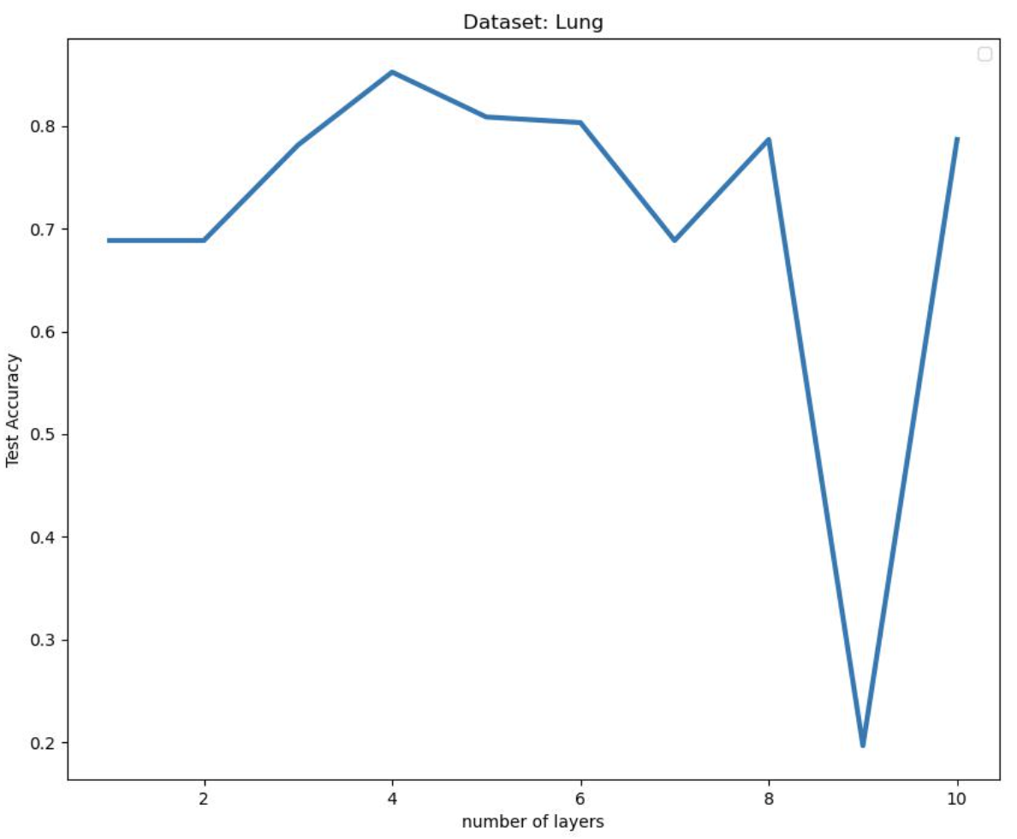
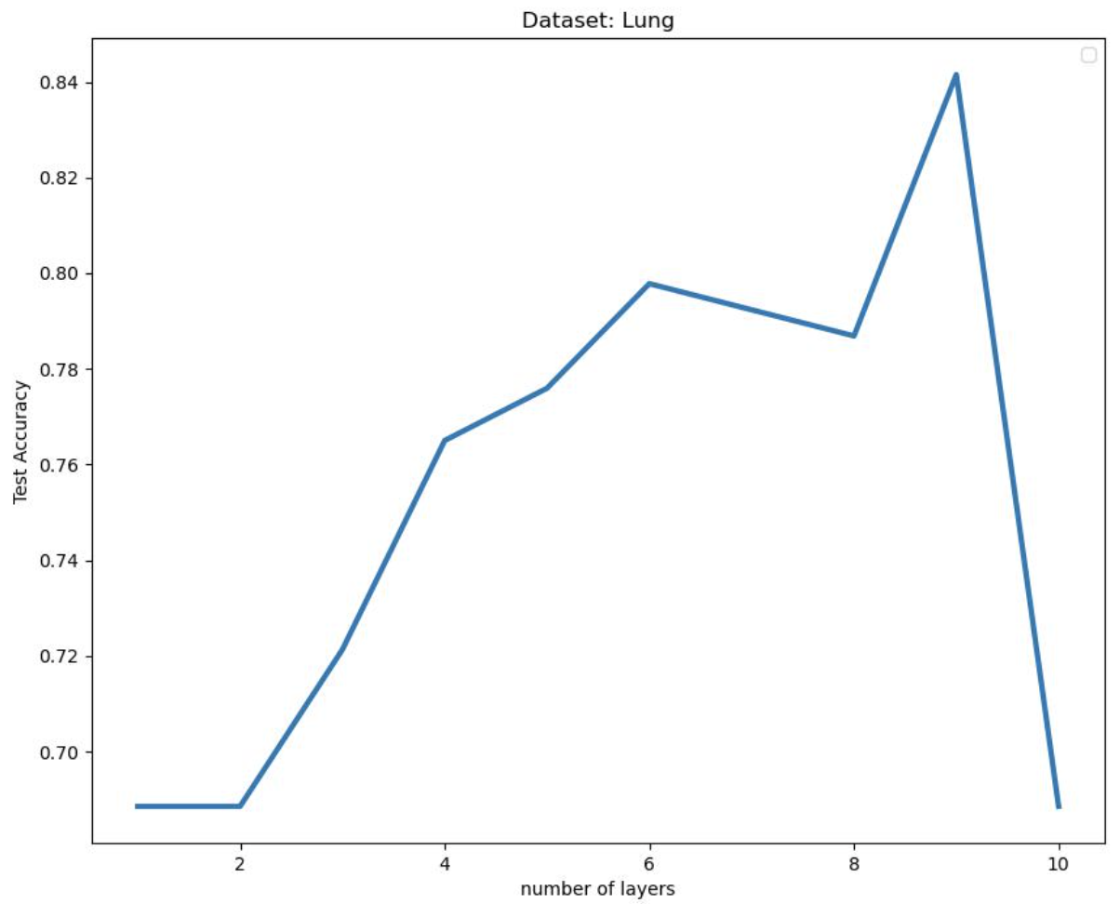
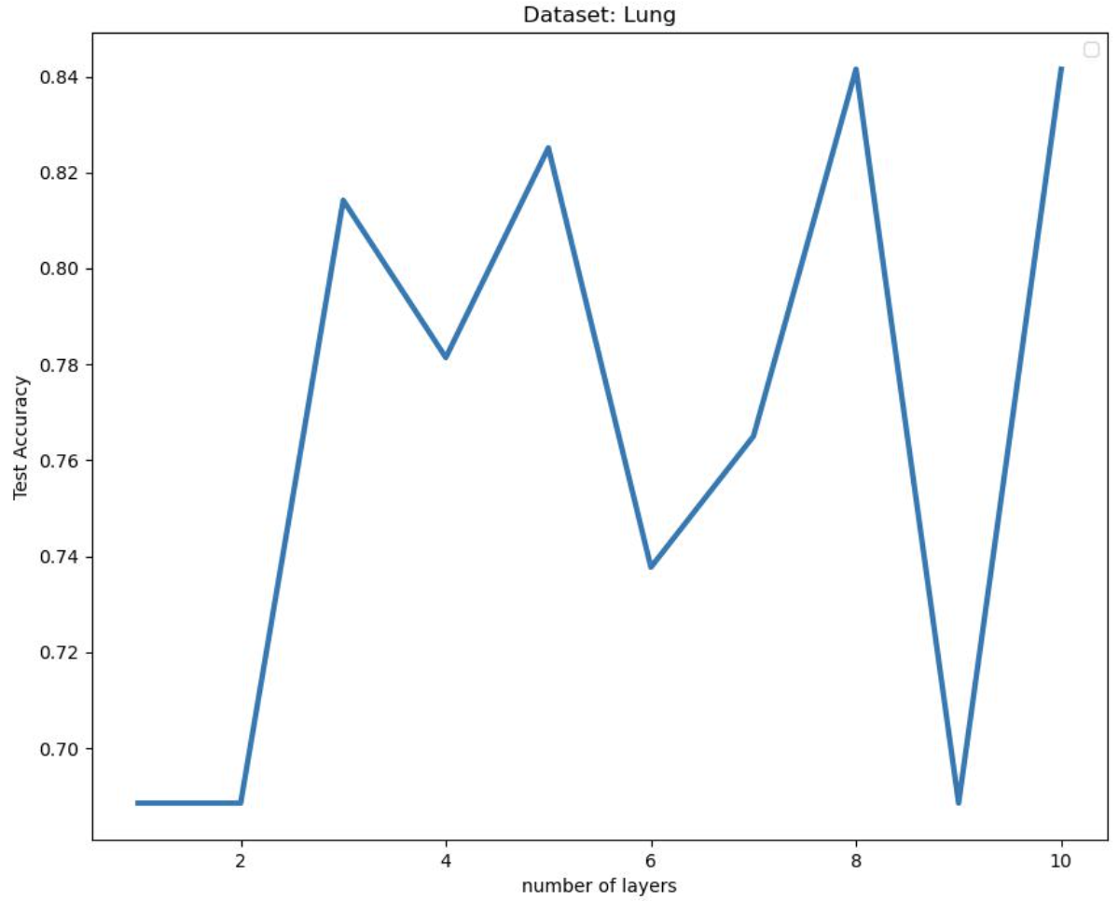
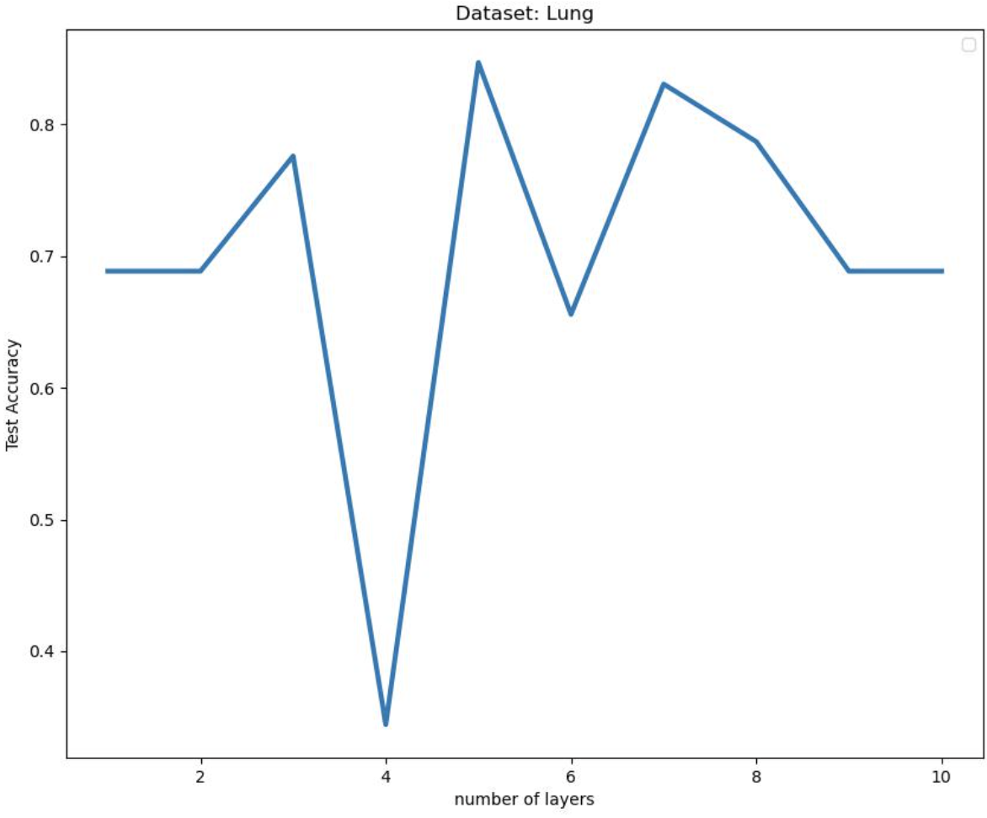
Lung层数曲线
Notes:
调参之后，我们发现张量GCN在不同的数据集下都可以和原版GCN打平，那么就需要寻找一种其他的定义方式来做。
我引入了ONMSC的这种定义方式，它找到ij的公共邻居k，统计相似度之和，这种方法的好处就是高阶拉普拉斯的复杂度降低了，因此速度和原版GCN几乎一样，并且可以在更大的数据集上测试，我简单的调整参数测试了一下，仍然是和原版GCN保持了一个比较接近的水平，那么这种方法上限可能也就这样了。

Slide 51
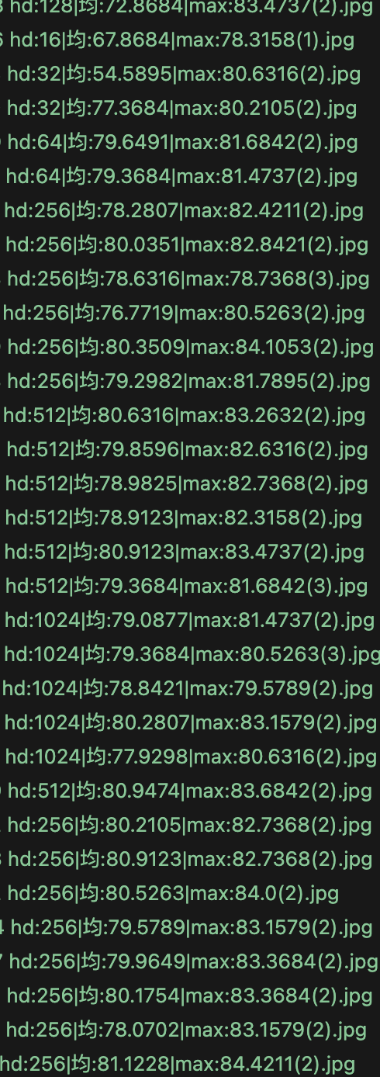
USPS1000实验结果
结果：
最高为84.4211(第二层)
出现了原版GCN在第二层最优，而后续acc逐渐下降的问题
在层数≥4时有时出现loss无穷大，在普通GCN中并不会出现这种情况
Notes:
调参之后，我们发现张量GCN在不同的数据集下都可以和原版GCN打平，那么就需要寻找一种其他的定义方式来做。
我引入了ONMSC的这种定义方式，它找到ij的公共邻居k，统计相似度之和，这种方法的好处就是高阶拉普拉斯的复杂度降低了，因此速度和原版GCN几乎一样，并且可以在更大的数据集上测试，我简单的调整参数测试了一下，仍然是和原版GCN保持了一个比较接近的水平，那么这种方法上限可能也就这样了。

Slide 52
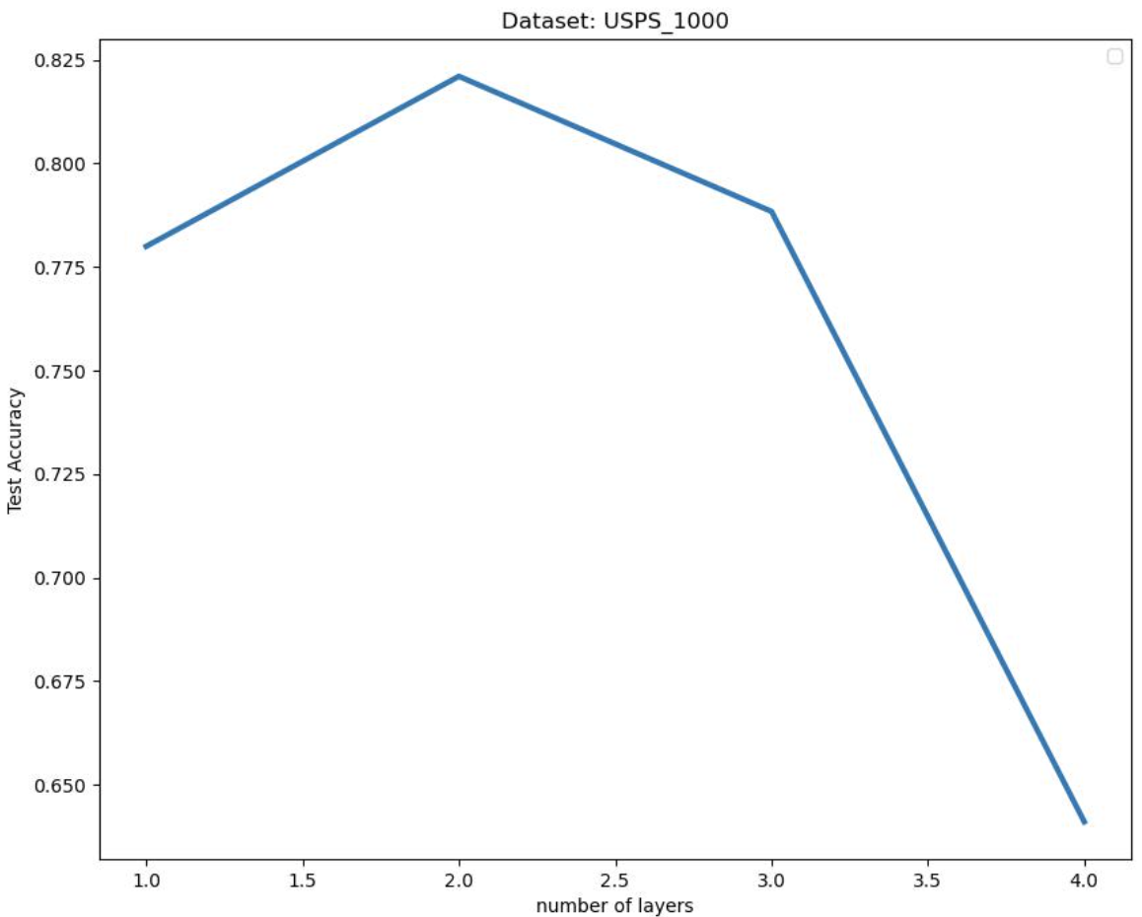
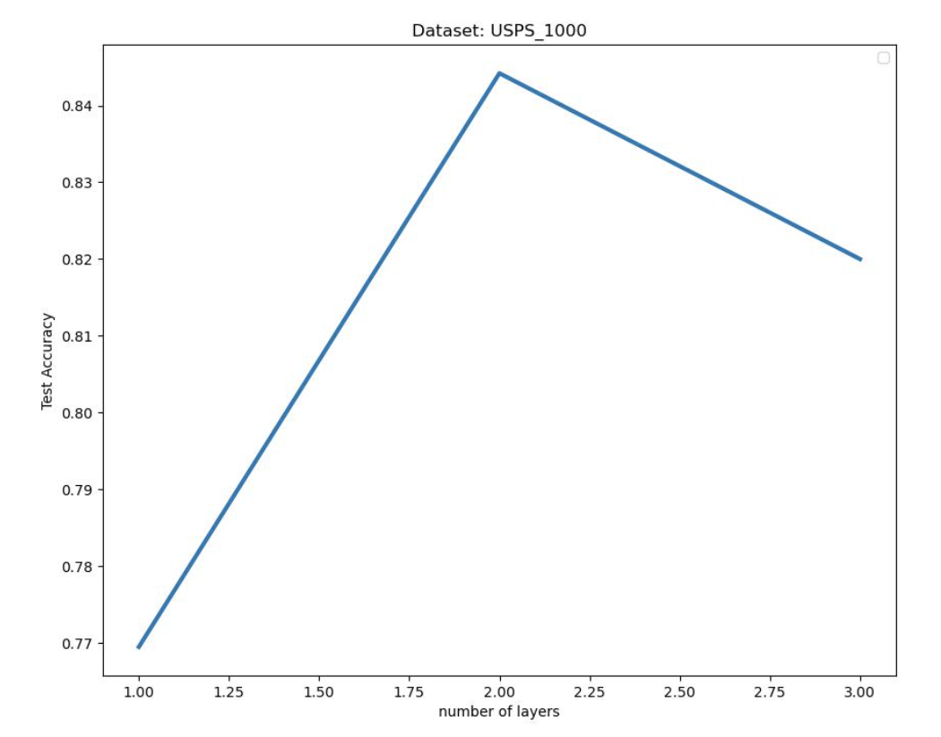
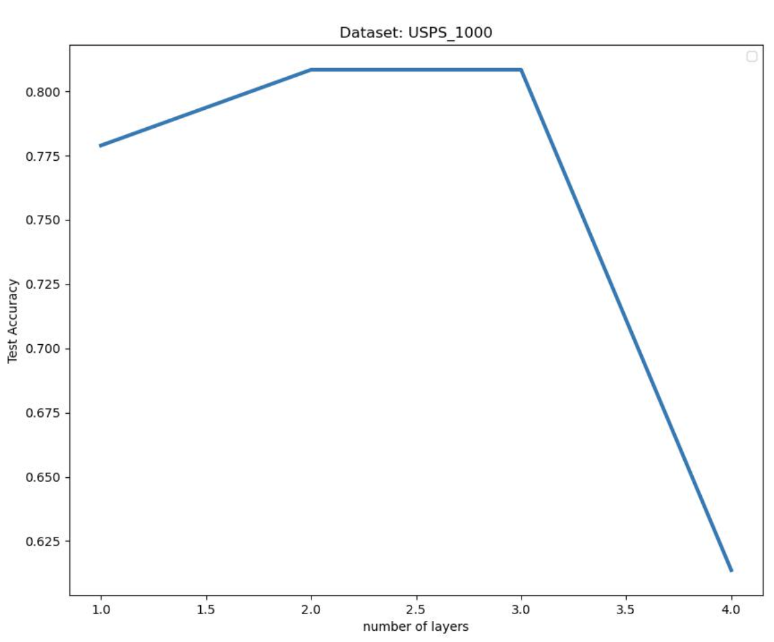

USPS层数曲线
Notes:
调参之后，我们发现张量GCN在不同的数据集下都可以和原版GCN打平，那么就需要寻找一种其他的定义方式来做。
我引入了ONMSC的这种定义方式，它找到ij的公共邻居k，统计相似度之和，这种方法的好处就是高阶拉普拉斯的复杂度降低了，因此速度和原版GCN几乎一样，并且可以在更大的数据集上测试，我简单的调整参数测试了一下，仍然是和原版GCN保持了一个比较接近的水平，那么这种方法上限可能也就这样了。

Slide 53
当前问题
张量GCN当前问题
一些数据集上效果不理想，如GLIOMA
没有找到层数相关规律
比原版GCN速度慢
下一步计划
尝试多种构图方式
更改半监督训练时的标签样本
更改权重矩阵或损失函数
完善更多数据集实验，添加其他评估维度(F-score, Purity...)
Notes:
GCN 使用的citation network 它是一种引用网络，自带图结构，所以它确实是适合GCN的应用，但是引用网络的节点数量太多，这导致拉普拉斯复杂度的大幅上升，即使可以体外计算也难以实现
然后目前尝试过的几种构建方式 都和原版GCN拉不开差距

Slide 54
小样本张量GCN
王朝颐
华南理工大学生物信息实验室
2023年8月25日

Slide 55
汇报大纲
实验结果
张量GCN构建推导问题
未来计划

Slide 56
小样本张量GCN实验
使用高斯核函数构建相似度矩阵，进行相似度六近邻构图
超参数：
网络层数
隐藏层维度
dropout
权重衰减
学习率
新增 F-score, Purity, Auc, Recall 作为评估指标
补充只使用部分相似度信息的实验

Slide 57

小样本张量GCN实验结果
实验结果

Slide 58





张量图卷积推导
Graph convolutions in the Fourier domain:
gθ(Λ)approximate gθ using Chebyshev polynomials Tk(x) up to Kth order:
=>
θ′ ∈ is now a vector of Chebyshev coefficients.
Simplify this formula:
Notes:
Someone may want to ask what salient object detection means and how to define the salient object. The saliency detection is to find clear foreground objects that are significantly different from the surrounding background in the image. The differences can be reflected in the color, texture and object shape. Let‘s see the first row in the figure. The input of the salient object detection is a digitized image and the output is a saliency probability map as in the second row. Each pixel of the input image has a calculated probability value in the probability map. The probability value is bigger, the probability is
higher that the pixel belongs to the salient object. Otherwise , if the probability value is small, it indicates a higher probability that the pixel belongs to the background. Generally, in the practical application, we apply a constant value in the probability map to separate the salient object from the input image. Just like the third row in the figure. Salient object detection can be used in many fields, like visual tracking, video matting and robot navigation.

Slide 59



张量图卷积推导
θ = θ_0′ = −θ_1′ :
Renormalization trick:
Final model:
Notes:
Someone may want to ask what salient object detection means and how to define the salient object. The saliency detection is to find clear foreground objects that are significantly different from the surrounding background in the image. The differences can be reflected in the color, texture and object shape. Let‘s see the first row in the figure. The input of the salient object detection is a digitized image and the output is a saliency probability map as in the second row. Each pixel of the input image has a calculated probability value in the probability map. The probability value is bigger, the probability is
higher that the pixel belongs to the salient object. Otherwise , if the probability value is small, it indicates a higher probability that the pixel belongs to the background. Generally, in the practical application, we apply a constant value in the probability map to separate the salient object from the input image. Just like the third row in the figure. Salient object detection can be used in many fields, like visual tracking, video matting and robot navigation.

Slide 60


张量化图卷积推导疑问
取$K=2$
$U\left(g_{θ}U^{⊤}x\right)=\sum_{k=0}^{K−1}{θ_{k}T_{k}(\tilde{L})x}=\left[{\overline{x}}_{0},…,{\overline{x}}_{K−1}\right]θ$ $=\left[{\overline{x}}_{0},{\overline{x}}_{1},{\overline{x}}_{2}\right]θ$ $=[x,\tilde{L}x,2{\tilde{L}}^{2}x−x]θ$
用$L_{3}$替换$2{\tilde{L}}^{2}$
$$=[x,\tilde{L}x,{f(L}_{3},x)−x]θ$$
$$=[x,\tilde{L}×_{2}x^{⊤},{ L}_{3}×_{2}x^{⊤}×_{3}x^{⊤})−x]θ$$
Notes:
Someone may want to ask what salient object detection means and how to define the salient object. The saliency detection is to find clear foreground objects that are significantly different from the surrounding background in the image. The differences can be reflected in the color, texture and object shape. Let‘s see the first row in the figure. The input of the salient object detection is a digitized image and the output is a saliency probability map as in the second row. Each pixel of the input image has a calculated probability value in the probability map. The probability value is bigger, the probability is
higher that the pixel belongs to the salient object. Otherwise , if the probability value is small, it indicates a higher probability that the pixel belongs to the background. Generally, in the practical application, we apply a constant value in the probability map to separate the salient object from the input image. Just like the third row in the figure. Salient object detection can be used in many fields, like visual tracking, video matting and robot navigation.

Slide 61
未来计划
张量GCN当前问题
推导可能存在问题
结果不够好
下一步计划
改变半监督数据划分方式(8:2)
补充参数分析实验
Notes:
GCN 使用的citation network 它是一种引用网络，自带图结构，所以它确实是适合GCN的应用，但是引用网络的节点数量太多，这导致拉普拉斯复杂度的大幅上升，即使可以体外计算也难以实现
然后目前尝试过的几种构建方式 都和原版GCN拉不开差距

Slide 62
GCN, HGNN, TGCN
王朝颐
华南理工大学生物信息实验室
2023年9月1日

Slide 63



GCN
图卷积：
Chebyshev polynomials 趋近:
Notes:
Someone may want to ask what salient object detection means and how to define the salient object. The saliency detection is to find clear foreground objects that are significantly different from the surrounding background in the image. The differences can be reflected in the color, texture and object shape. Let‘s see the first row in the figure. The input of the salient object detection is a digitized image and the output is a saliency probability map as in the second row. Each pixel of the input image has a calculated probability value in the probability map. The probability value is bigger, the probability is
higher that the pixel belongs to the salient object. Otherwise , if the probability value is small, it indicates a higher probability that the pixel belongs to the background. Generally, in the practical application, we apply a constant value in the probability map to separate the salient object from the input image. Just like the third row in the figure. Salient object detection can be used in many fields, like visual tracking, video matting and robot navigation.

Slide 64





GCN
取 K = 1:
renormalization trick:
Generalize:
Notes:
Someone may want to ask what salient object detection means and how to define the salient object. The saliency detection is to find clear foreground objects that are significantly different from the surrounding background in the image. The differences can be reflected in the color, texture and object shape. Let‘s see the first row in the figure. The input of the salient object detection is a digitized image and the output is a saliency probability map as in the second row. Each pixel of the input image has a calculated probability value in the probability map. The probability value is bigger, the probability is
higher that the pixel belongs to the salient object. Otherwise , if the probability value is small, it indicates a higher probability that the pixel belongs to the background. Generally, in the practical application, we apply a constant value in the probability map to separate the salient object from the input image. Just like the third row in the figure. Salient object detection can be used in many fields, like visual tracking, video matting and robot navigation.

Slide 65






HGNN
超图标准化拉普拉斯：
超图卷积&切比雪夫：
HGNN采用GCN一样的假设得到的超图卷积:
原版GCN的图卷积：
同样合并参数避免过拟合：
Generalize：
Notes:
Someone may want to ask what salient object detection means and how to define the salient object. The saliency detection is to find clear foreground objects that are significantly different from the surrounding background in the image. The differences can be reflected in the color, texture and object shape. Let‘s see the first row in the figure. The input of the salient object detection is a digitized image and the output is a saliency probability map as in the second row. Each pixel of the input image has a calculated probability value in the probability map. The probability value is bigger, the probability is
higher that the pixel belongs to the salient object. Otherwise , if the probability value is small, it indicates a higher probability that the pixel belongs to the background. Generally, in the practical application, we apply a constant value in the probability map to separate the salient object from the input image. Just like the third row in the figure. Salient object detection can be used in many fields, like visual tracking, video matting and robot navigation.

Slide 66





Tensor GCN
在切比雪夫中取K = 2：
将 替换为 ：
Generalize：
Notes:
Someone may want to ask what salient object detection means and how to define the salient object. The saliency detection is to find clear foreground objects that are significantly different from the surrounding background in the image. The differences can be reflected in the color, texture and object shape. Let‘s see the first row in the figure. The input of the salient object detection is a digitized image and the output is a saliency probability map as in the second row. Each pixel of the input image has a calculated probability value in the probability map. The probability value is bigger, the probability is
higher that the pixel belongs to the salient object. Otherwise , if the probability value is small, it indicates a higher probability that the pixel belongs to the background. Generally, in the practical application, we apply a constant value in the probability map to separate the salient object from the input image. Just like the third row in the figure. Salient object detection can be used in many fields, like visual tracking, video matting and robot navigation.

Slide 67
小样本张量GCN
王朝颐
华南理工大学生物信息实验室
2023年10月7日

Slide 68
Tensor GCN
在切比雪夫中取K = 2：
将 替换为 ：
Generalize：

Slide 69


小样本张量GCN实验
使用高斯核函数构建相似度矩阵，进行相似度六近邻构图
超参数：网络层数, 隐藏层维度, dropout, 权重衰减, 学习率
使用不可分解相似度(UTC相似度)计算高阶拉普拉斯
超参搜索实验：设置如下：

Slide 70

小样本张量GCN实验结果
实验结果

Slide 71
问题与计划
很多生信小样本数据集表现不良(SMK_CAN等)
权重矩阵太大，样本数太少
Pr，Auc等指标统计范围是全部样本，而非测试样本
张量GCN当前问题
未来计划
继续补充参数分析实验 加入更多数据集
尝试合并三个 theta
尝试解释高阶相似度的替换
更新Pr，Auc等指标的统计范围
尝试其他的高阶不可分解相似度(TSC)

Slide 72
小样本张量GCN
王朝颐
华南理工大学生物信息实验室
2023年11月3日

Slide 73

小样本张量GCN实验
模型改进尝试：
尝试特征预编码后建图以实现特征降维
修复高斯核函数bug，使用不同sigma的高斯核函数建图
尝试使用不同K执行KNN建图
修复UTC三阶张量表示方法
当前暂无更好结果更新

Slide 74
A Hierarchical Graph Convolution Network for Representation Learning of Gene Expression
王朝颐
华南理工大学生物信息实验室
2023年11月3日

Slide 75


Hierarchical Graph Convolution Network (HiGCN)
两种Graph：Gene Graph(G_g) / Sample Graph(G_s)
Sparse GCN (Feature Space)
The Hadamard product between A(g) and W(0) produces a new weight matrix where only interacting genes have weights. Thus, the connection between the input layer and the first layer is sparse, and the new matrix contains the structural information of the gene graph
Feature-weighted GCN(Sample Space)

Slide 76


Hierarchical Graph Convolution Network (HiGCN)

Slide 77
提出问题与解决方案
HiGCN：
问题1：高维小样本维度诅咒
方案：聚合Feature Space和Sample Space信息
问题2：生信数据标签获取难度大
方案：transductive learning
问题3: 传统GCN可解释性不足
方案：结合两种GCN实现重要特征选择
TGCN：
问题1：生信数据标签获取难度大
方案：transductive learning
问题2：基于两两相似性的距离度量缺少高阶邻域信息
方案：引入高阶相似度
问题3: 传统GCN表达能力不足/过平滑
方案：高阶相似度+dropout+深层网络

Slide 78
近期汇报
王朝颐
华南理工大学生物信息实验室
2023年11月28日

Slide 79

Polygonal Straight Skeleton Generation Algorithm Based on GA Engine
Straight Skeletons:
直骨架定义:
多边形的边以相同速度多边形内部收缩时 多边形顶点经过的轨迹(一般而言为角平分线方向)
生成算法：Bisector Propagation
算法目标
设计时间复杂度O(N), 且工程上稳定的直骨架算法
算法应用：Pattern Matching / DRC
预期产出：
专利/论文

Slide 80
张量GCN总结
王朝颐
华南理工大学生物信息实验室
2023年11月28日

Slide 81







Spectral Graph Convolution/ChebyNet
卷积定理：信号的卷积的傅立叶变换与信号先做傅立叶变换后相乘等价。对于一个简单的图卷积 x * g，有：
对应卷积核在傅立叶域中的形式，它可以被表示为特征值的函数
ChebyNet使用Chebyshev polynomials参数化卷积核
Notes:
Someone may want to ask what salient object detection means and how to define the salient object. The saliency detection is to find clear foreground objects that are significantly different from the surrounding background in the image. The differences can be reflected in the color, texture and object shape. Let‘s see the first row in the figure. The input of the salient object detection is a digitized image and the output is a saliency probability map as in the second row. Each pixel of the input image has a calculated probability value in the probability map. The probability value is bigger, the probability is
higher that the pixel belongs to the salient object. Otherwise , if the probability value is small, it indicates a higher probability that the pixel belongs to the background. Generally, in the practical application, we apply a constant value in the probability map to separate the salient object from the input image. Just like the third row in the figure. Salient object detection can be used in many fields, like visual tracking, video matting and robot navigation.

Slide 82

Spectral Graph Convolution/ChebyNet
由此便定义和表示了傅立叶域上的图卷积 x * g：
进一步的，根据切比雪夫多项式提前计算出每一项，可以去掉k阶项并将图卷积转化成普通的分块矩阵乘法：
Notes:
Someone may want to ask what salient object detection means and how to define the salient object. The saliency detection is to find clear foreground objects that are significantly different from the surrounding background in the image. The differences can be reflected in the color, texture and object shape. Let‘s see the first row in the figure. The input of the salient object detection is a digitized image and the output is a saliency probability map as in the second row. Each pixel of the input image has a calculated probability value in the probability map. The probability value is bigger, the probability is
higher that the pixel belongs to the salient object. Otherwise , if the probability value is small, it indicates a higher probability that the pixel belongs to the background. Generally, in the practical application, we apply a constant value in the probability map to separate the salient object from the input image. Just like the third row in the figure. Salient object detection can be used in many fields, like visual tracking, video matting and robot navigation.

Slide 83





GCN
GCN对切比雪夫多项式取 K=1 并进一步简单化处理：
进一步简化&Renormalization trick：

Slide 84
Tensor GCN
替换动机： 二阶邻域表示能力不足 => 替换
逼近: 参数可学习 修改卷积结构
L 线性，HDLSS 下拉普拉斯不太精确，
这里先介绍 k 越大 卷积核域越大 但三阶的L^2误差放大问题
A => L
噪音分析,
在切比雪夫中取K = 2：
将 替换为 ：
Generalize：

Slide 85


TGCN实验结果与模型概览
Notes:
Someone may want to ask what salient object detection means and how to define the salient object. The saliency detection is to find clear foreground objects that are significantly different from the surrounding background in the image. The differences can be reflected in the color, texture and object shape. Let‘s see the first row in the figure. The input of the salient object detection is a digitized image and the output is a saliency probability map as in the second row. Each pixel of the input image has a calculated probability value in the probability map. The probability value is bigger, the probability is
higher that the pixel belongs to the salient object. Otherwise , if the probability value is small, it indicates a higher probability that the pixel belongs to the background. Generally, in the practical application, we apply a constant value in the probability map to separate the salient object from the input image. Just like the third row in the figure. Salient object detection can be used in many fields, like visual tracking, video matting and robot navigation.

Slide 86
Tensor GCN 写作思路
尝试解决的科学问题：
问题1：生信数据标签获取难度大 （问题太大）
方案：transductive learning
问题2：基于两两相似性的距离度量缺少高阶邻域信息
方案：引入高阶相似度
问题3: 传统GCN表达能力不足/过平滑 (难以证明)
方案：高阶相似度+dropout+深层网络
当前疑问：
模型引入问题

Slide 87
TGCN
王朝颐
华南理工大学生物信息实验室
2023年12月25日

Slide 88

TGCN 实验进展
添加对比实验模型 ChebNet（基于 HDLSS 数据集）
修复数据集 Colon，Leukemia，CLL_SUB的特征归一化问题
修复数据集 ALLAML, Leukemia 计算UTC 相似度小于 0问题
修正 F-Score, AUC, Recall 统计范围，当前只统计测试样本
其他 bug 修复和实验优化

Slide 89
TGCN 实验进展
添加对比实验模型 ChebNet（基于 HDLSS 数据集）
修复数据集 Colon，Leukemia，CLL_SUB的特征归一化问题
修复数据集 ALLAML, Leukemia 计算UTC 相似度小于 0问题
修正 F-Score, AUC, Recall 统计范围，当前只统计测试样本
其他 bug 修复和实验优化

Slide 90
TGCN 实验计划
正在做：
新的参数搜索实验结果尚未更新完毕
F-Score等指标去除训练样本后反而上升
消融实验
噪声实验
收敛性实验图表
参数分析图表

Slide 91

TGCN 实验结果更新

Slide 92
TGCN 实验结果更新

Slide 93
TGCN 实验计划
正在做：
新的参数搜索实验结果尚未更新完毕
F-Score等指标去除训练样本后反而上升
消融实验
噪声实验
收敛性实验图表
参数分析图表

Slide 94
2023 年工作小结
王朝颐
华南理工大学生物信息实验室
2024年1月19日

Slide 95
2023 年度工作小结
论文阅读与撰写
论文工作：Tensor-GCN
其他工作与未来计划

Slide 96
论文工作
Tensor based Graph Convolutional Networks for HDLSS Data
工作背景：多项式卷积核简化了谱域图卷积的设计，同时具有良好的性能，但局限于浅层模型且对高维数据，尤其是高维小样本数据表示能力欠佳。 提升卷积核感受野(多项式阶数)的方式可以捕获一定高阶信息，但由于图结构使用的点点相似度难以刻画复杂关系，以及拉普拉斯矩阵的线性特点，使得这种尝试难以使模型取得更好效果。
工作创新点：使用不可分解张量相似度直接对特征进行高维建模，并设计融合低维与高维信息的统一图卷积网络模型
具体任务：在高维小样本数据上进行节点(样本)半监督分类
工作难点：1. 张量相似度计算复杂度高 2. HDLSS 数据本身不具备图结构
工作进度：当前正在修改，待投。

Slide 97
其他工作与未来计划
其他工作
BIIP2022志愿者
其他实验室公共事务
未来计划
论文投稿与修订

Slide 98
Tensor Graph Convolutional Networks for High-dimensional and Low-sample Size Data
王朝颐
华南理工大学生物信息实验室
2024年2月28日

Slide 99
论文工作回顾
贡献
在图卷积中引入有效描述多个样本内在联系的张量相似度，提供点点相似性缺少的信息
提供有效融合低阶与高阶信息的多层 GCN 框架，实现精准和鲁邦的预测
实验结果证明 Tensor-GCN 在半监督分类下的优秀性能，且模型尤为擅长处理HDLSS数据

Slide 100

论文工作回顾
框架图

Slide 101

论文工作回顾
方法: High-order Graph Convolutions
直觉构建方法
困境：拉普拉斯基于点点相似性构建，忽略高阶信息将在图卷积过程中产生误差，高次幂的拉普拉斯矩阵则将误差放大

Slide 102


论文工作回顾
方法: High-order Graph Convolutions
基于张量相似性的图卷积过程(Y_k 作为多项式卷积核)
新的图卷积定义
扩展后的迭代模型

Slide 103

论文工作回顾：对比实验

Slide 104

论文工作回顾：可视化实验

Slide 105
未来计划
实验修改
继续尝试在传统图数据上证明效果
代码重构后开源
实验补充
训练曲线
噪声实验
其他可视化(混淆矩阵)
方法修改
多项式卷积核Y_k(x)可以扩展至 n 阶，但需证明其与图卷积的联系

Slide 106
Adaptive Universal Generalized PageRank Graph Neural Network（GPRGNN）
王朝颐
华南理工大学生物信息实验室
2024年4月 ？？日

Slide 107



Existing GCN methodology: stacking GCN layers
Graph Convolutional Networks (GCN) (Kipf et al. 2016)
特点：
图拓扑信息（邻接矩阵）作为自特征层的传播，与该层的变换矩阵相乘，非线性变换通过激活函数补足

Slide 108
Fundamental weaknesses of existing GCN methods
一般性 （同源偏好假设）
假设：同类/相似的节点间建立边的可能性更高
Over-smoothing 问题
容易丧失来自节点特征的信息

Slide 109
GPR-GNN
一般性 （同源偏好假设）
假设：同类/相似的节点间建立边的可能性更高
Over-smoothing 问题
容易丧失来自节点特征的信息

Slide 110
近期汇报
王朝颐
华南理工大学生物信息实验室
2024年5月6日

Slide 111
近期工作
SIGKDD Rebuttal & Interaction
实验
对比方法添加4种 (MLP, HiGCN, GRACES, HGNN)
常规数据集(抽样) 上的结果
运行时间 (考虑建图时间)
原稿修改
添加时间复杂度分析
文章内容微调

Slide 112


实验结果(supplement)
Dataset: USPS(400)

Slide 113




实验结果
复杂度分析 / 运行时间
$$N^{2}C+N^{2}C+{ N}^{3}C+NCF=N^{3}C$$

Slide 114
Distributed Constrained Combinatorial Optimization leveraging Hypergraph Neural Networks
王朝颐
华南理工大学生物信息实验室
2024年6月7日

Slide 115


Problem Setting
约束求解模型:
难点：
non-convex/non-linear的目标和约束
优化变量可以是离散取值(GD类方法失效)

Slide 116

Problem Setting
解决方案:
方案：
将状态空间松弛为连续空间，解决满足连续性的优化问题， 再把解映射回原空间
HypOP: HGNN作为可学习转换函数

Slide 117

Overview of HypOP framework
Framework：
1. Hypergraph modeling
2. Solving the relaxed problem using hgnn.(unsupervised)
3. Post-processing mapping (continous output => discrete value)
Notes:
整个的过程, 简单来说就是, 对于一个不好优化的问题, 我们通过变换函数, 把这个问题给它变成一个可以求解的替换问题, 然后再把替换问题的解给他变回原来问题的解
在这个流程里, 作者把这个变换给他参数化, 然后用 HGNN 求解一个最优的变换, 以及这个问题在变换之后的解, 最后呢再走最后一步, 把它给映射回原来的空间

Slide 118
1. Hypergraph Modeling
解决方案:
Notation：
问题如果本身自带 graph(hypergraph) 结构, 如求超图的MatCut, 则缺省建模过程

Slide 119




2. HyperGNN as the Learnable Transformation Function
解决方案:
离散
连续
参数化, 连续
Notes:
然后这里就是它的核心了, 前面提到, 我们需要对原问题进行 transform 以使得基于梯度的优化发挥作用, 也就是说需要把 这个约束x_Nk 转成一个连续的, 在这里用 p_nk表示
正常情况下呢, 我们要选一个转换函数, 转为连续的之后就直接开始梯度下降, 然后配合一个惩罚, 让它的求解不要离开原问题的解的范围, 然后直接迭代就好了.
但作者这里说, 这个转换我可以学习, 在建了约束超图之后, 这 p_i 是我给节点 i 的值, 他一定是连续的, x 用过了所以这里我用 sigma 表示初始嵌入, 也就是我的feature, W 是weight, 我优化这个 sigma, 学我的 W, 这个 W 就作为我变化函数的参数向量
所以说呢, 最开始我们约束中的变量 x 是在d0一直到到d_v 这个范围之内离散取值,
到转换为的 p 以及最后参数化成 hgnn 的输出 G_i , 经过了这样的一个过程, 并且转换之后, 我们的约束变量是在d0到 dv间连续取值了, 现在这个问题就是最终的, 我们的relaxed 问题

Slide 120


2. HyperGNN as the Learnable Transformation Function
loss:
layer-wise model:
Notes:
那么现在问题已经建模好了, 就可以跑起来 HGNN了, 这个问题的 loss, 或者说惩罚函数,
就是: 对于每一个约束k, 假如这个约束方程 > 0, 那他就乘上这条约束的权重添加到 loss 里, 看起来是通过这个 loss 来让它向 0 逼近
然后作者据此提出了他的 HGNN, 就是一个很经典的GNN, 用上了超图拉普拉斯, 这个形式是和正常的一样
到这里, 我们就用HGNN求解 原约束方程 在连续空间内的松弛版本, 接下来就需要把求得的这个连续的解, 重新给他映射回离散的空间里, 首先要简单介绍一下他后面用的这个 模拟退火

Slide 121


Simulated Annealing/SA: 模拟退火
pseudo-code
总的来说, SA 的流程就是:
温度从初始值逐渐降低到0，每个时间步长内，算法随机选择一个与当前解接近的解，并根据与温度相关的概率选择当前更优的解参与下一轮迭代。SA 概率收敛至最优解
Notes:
简单来说, 首先初始化 s0和能量 E
每一次迭代:
当前状态s的某邻态 sn, 一般来说这里都会使用比较简单的变换, 再算出这个邻态的能量 En, 并且呢以一定接受概率决定是否移动到这个邻态sn上, 这个 sn 的能量相对越低, 移动到它的概率就越高. 最后假如能量已经低于设定的阈值或者 迭代次数超过规定的最高次数, 就会退
这个方法的一个特点就是可以规避局部最优, 同时解空间特别大的时候也比较好用.
而且看起来好像是一个启发式算法, 但是实际上只要你的迭代次数足够多, 它是依概率收敛到全局最优解的

Slide 122

3. Mapping with Simulated Annealing
根据 HGNN 的输出获取 x 离散取值 {d_0, ..., d_v}的概率分布
映射过程：从p1到p_n的输出分布中取样x_1, ..., x_n, 用该样本作为初始值启动SA求最优解
Notes:
这一步就是要把 hgnn 的输出重新转化成离散的整数, 它的范围就是d0到dv之间, 这个映射的规则就是
这个离散值和连续值的距离越短, 那么取到这个离散值的概率就越高, 符合直觉.
映射过程：从p1到p_n的输出分布中取样x_1, ..., x_n, 用该样本作为初始值启动SA求最优解
这里有一点绕， 相当于HGNN得到的是，一个连续的p， 以及SA的启动值，最终的解还是用模拟退火在刚才得到的概率分布中找到的

Slide 123

分布式 HypOp
分布式： 每个GPU持有一部分超图来训练
Notes:
给定超图 G = (V, E) 和 S 个用于训练模型 M 的GPU
先把 G 划分为 S 个子图, 对于 任意一个子图 G_s而言. 它包含 3 个组件: Vs 表示 Gs 中的节点，Es,inner 包括连接 Gs 内节点的内部超边，而 Es,outer 包括连接 Gs 与其他子图节点的外部超边, 一个是内部一个是外部
在前向传播期间，每个GPU使用 Es,inner 计算本地节点嵌入，并在反向传播期间，使用本地节点嵌入和 Es,outer 连接的节点嵌入计算损失，以更新模型权重 Ms。随后，各 Ms 的梯度会被聚合并分发到所有GPU。

Slide 124

并行 HypOp
分布式： 每个GPU持有一部分超图来训练
Notes:
给定一个输入超图 G = (V, E) 和 S 个GPU，每个GPU上初始化HGNN模型 M。
在每个epoch中，超图 G 的超边信息 E 随机划分为 S 部分。
然后，每个GPU接收其对应的超边 Es 并在其上训练 Ms。
梯度随后会被聚合并分发到所有GPU。
作者这个盘子铺的很大, 既可以分布式又可以并行, 这样可以解决超大规模的问题

Slide 125
Experiments
下游应用:
超图/图的 MaxCut
Graph Maximum Independent Set (MIS)
Satisfiability (SAT)
Resource Allocation problems
迁移学习
实际应用: 国家药物控制
Notes:
实验部分, 没来得及细看, 作者这里是提供了几种下游应用, 然后模型可以冻结权重并且做迁移学习, 作者甚至还做了一个实际应用, 看起来好像效果都很好, 主要是这个也很快, 然后放到大规模应用上也没有压力. 看的出来确实是实力雄厚

Slide 126

Experiments
MaxCut:
Baseline: ADAM, SA
Notes:
其中MaxCut 就是说把节点分成两组, 且这个切割大小要最大, 大小指的是连接了不同类节点的超边的数量
作者选的 baseline 是 ADAM 和SA, 这里的SA实际上是不进行 HGNN 的训练, 直接输出然后随机初始化在开始 SA, 其实就相当于是消融
效果相当, 但是作者的方法基本上是线性的, 所以就有优势

Slide 127

Experiments
Maximum Independent Set Problem:
Notes:
最大独立集就是, 要找到一个最大的顶点集合，使得这些顶点之间没有相邻的边。这个最大的顶点集合被称为图的最大独立集。
同样也是, 效果不错, 时间更短

Slide 128
LIMITATIONS: PHASE TRANSITION IN GNN PERFORMANCE
对当前工作的一些启示:
作者提出 GNN 在dense graph 上的效果会变差, 可以试着对 graph 进行一个 sparsification
ref: Dropedge:Towards deep graph convolutional networks on node classification. (ICLR 2019)
Notes:
在附录里作者提了一些当前 基于学习的优化 存在的一些问题, 其中作者有提到 GNN 在密集图上的效果会变差, 我觉得这个可能是一个后续修改的启发, 因为目前我的这个无论是 UTC 还是 KNN 都有些过于密集了, 我准备去读一下他给的这个参考文献

Slide 129
近期工作汇报
王朝颐
华南理工大学生物信息实验室
2024年6月27日

Slide 130
近期工作
ICDM Submission
修改内容同步 & 总结
Distributed Constrained Combinatorial Optimization leveraging Hypergraph Neural Networks

Slide 131
ICDM Submission
论文修改
标题修改
格式改为 IEEE 会议(双列)
其他小修
实验部分修改
对比实验部分重写
添加Running time analysis

Slide 132



工作当前不足
理论
卷积Kernel Y_k(x)

Slide 133


工作当前不足
理论
对于HDLSS数据的建图处理
复杂度高

Slide 134
工作当前不足
实验效果
理论
可能支持扩展 ?
到底是不是 MLP + 高阶相似度 ?
实验
GCN 作为backbone, 限制了性能上限
复杂度
权重初始化对结果的影响较大

Slide 135
Distributed Constrained Combinatorial Optimization leveraging Hypergraph Neural Networks
王朝颐
华南理工大学生物信息实验室
2024年6月27日

Slide 136
Problem Setting
约束求解模型:
难点：
non-convex/non-linear的目标和约束
优化变量可以是离散取值(GD类方法失效)

Slide 137
Problem Setting
解决方案:
方案：
将状态空间松弛为连续空间，解决满足连续性的优化问题， 再把解映射回原空间
HypOP: HGNN作为可学习转换函数

Slide 138
Overview of HypOP framework
Framework：
1. Hypergraph modeling
2. Solving the relaxed problem using hgnn.(unsupervised)
3. Post-processing mapping (continous output => discrete value)
Notes:
整个的过程, 简单来说就是, 对于一个不好优化的问题, 我们通过变换函数, 把这个问题给它变成一个可以求解的替换问题, 然后再把替换问题的解给他变回原来问题的解
在这个流程里, 作者把这个变换给他参数化, 然后用 HGNN 求解一个最优的变换, 以及这个问题在变换之后的解, 最后呢再走最后一步, 把它给映射回原来的空间

Slide 139
2. HyperGNN as the Learnable Transformation Function
解决方案:
离散
连续
参数化, 连续
Notes:
然后这里就是它的核心了, 前面提到, 我们需要对原问题进行 transform 以使得基于梯度的优化发挥作用, 也就是说需要把 这个约束x_Nk 转成一个连续的, 在这里用 p_nk表示
正常情况下呢, 我们要选一个转换函数, 转为连续的之后就直接开始梯度下降, 然后配合一个惩罚, 让它的求解不要离开原问题的解的范围, 然后直接迭代就好了.
但作者这里说, 这个转换我可以学习, 在建了约束超图之后, 这 p_i 是我给节点 i 的值, 他一定是连续的, x 用过了所以这里我用 sigma 表示初始嵌入, 也就是我的feature, W 是weight, 我优化这个 sigma, 学我的 W, 这个 W 就作为我变化函数的参数向量
所以说呢, 最开始我们约束中的变量 x 是在d0一直到到d_v 这个范围之内离散取值,
到转换为的 p 以及最后参数化成 hgnn 的输出 G_i , 经过了这样的一个过程, 并且转换之后, 我们的约束变量是在d0到 dv间连续取值了, 现在这个问题就是最终的, 我们的relaxed 问题

Slide 140
2. HyperGNN as the Learnable Transformation Function
loss:
layer-wise model:
Notes:
那么现在问题已经建模好了, 就可以跑起来 HGNN了, 这个问题的 loss, 或者说惩罚函数,
就是: 对于每一个约束k, 假如这个约束方程 > 0, 那他就乘上这条约束的权重添加到 loss 里, 看起来是通过这个 loss 来让它向 0 逼近
然后作者据此提出了他的 HGNN, 就是一个很经典的GNN, 用上了超图拉普拉斯, 这个形式是和正常的一样
到这里, 我们就用HGNN求解 原约束方程 在连续空间内的松弛版本, 接下来就需要把求得的这个连续的解, 重新给他映射回离散的空间里, 首先要简单介绍一下他后面用的这个 模拟退火

Slide 141
Simulated Annealing/SA: 模拟退火
pseudo-code
总的来说, SA 的流程就是:
温度从初始值逐渐降低到0，每个时间步长内，算法随机选择一个与当前解接近的解，并根据与温度相关的概率选择当前更优的解参与下一轮迭代。SA 概率收敛至最优解
Notes:
简单来说, 首先初始化 s0和能量 E
每一次迭代:
当前状态s的某邻态 sn, 一般来说这里都会使用比较简单的变换, 再算出这个邻态的能量 En, 并且呢以一定接受概率决定是否移动到这个邻态sn上, 这个 sn 的能量相对越低, 移动到它的概率就越高. 最后假如能量已经低于设定的阈值或者 迭代次数超过规定的最高次数, 就会退
这个方法的一个特点就是可以规避局部最优, 同时解空间特别大的时候也比较好用.
而且看起来好像是一个启发式算法, 但是实际上只要你的迭代次数足够多, 它是依概率收敛到全局最优解的

Slide 142



3. Mapping with Simulated Annealing
根据 HGNN 的输出获取 x 离散取值 {d_0, ..., d_v}的概率分布
映射过程：从p1到p_n的输出分布中取样x_1, ..., x_n, 用该样本作为初始值启动SA求最优解
问题举例:
Notes:
这一步就是要把 hgnn 的输出重新转化成离散的整数, 它的范围就是d0到dv之间, 这个映射的规则就是
这个离散值和连续值的距离越短, 那么取到这个离散值的概率就越高, 符合直觉.
映射过程：从p1到p_n的输出分布中取样x_1, ..., x_n, 用该样本作为初始值启动SA求最优解
这里有一点绕， 相当于HGNN得到的是，一个连续的p， 以及SA的启动值，最终的解还是用模拟退火在刚才得到的概率分布中找到的

Slide 143
[ICML '23] Graph Neural Networks can Recover the Hidden Features Solely from the Graph Structure
王朝颐
华南理工大学生物信息实验室
2024年7月31日

Slide 144

1 Intro
GNN算法的核心：平滑滤波 (filtering)。GNN通过聚合节点信息生成embedding
GNN算法的传统视角：在图结构上进行消息传递，i.e., 在图上对特征进行平滑

Slide 145

1 Intro: 平滑滤波视角下的GNN
不从给定的输入(特征&拓扑结构)中产生(学习)额外信息[1, 2]。
仅通过`平滑` 接收和聚合信息
特征 X 是信息的载体，邻接矩阵 A 辅助信息的传播
两点推论：
不使用图结构，只输入特征： GNN => MLP
没有特征/特征是拓扑结构本身：无法学习有效表示
1. Li, Q., Han, Z., and Wu, X. Deeper insights into graph convolutional networks for semi-supervised learning.
2. NT, H. and Maehara, T. Revisiting graph neural networks: All we have is low-pass filters.

Slide 146

1 Intro: GNN可以从拓扑重建特征
作者观点：GNNs can create new useful node features by themselves even when the input node features are uninformative.
GNN能仅从拓扑结构中还原一部分真实的特征信息

Slide 147


2 Feature Recovery: Problem Setting
特征恢复：不提供特征，仅将图的结构暴露给GNN，让GNN从中学习原始特征 z
特殊的图生成任务：学习特征 z 的分布/流形 p(z)
Metric: orthogonal Procrustes distance,

Slide 148

2 Feature Recovery: Intuition & Difficulty
Attempt: 利用局部结构学习流形
特征度量学习 => 节点的距离和其特征相关性并无联系
节点中心性 => 特征密度与拓扑结构也无关
方案:利用Random Walk估计特征分布
依据: 在有大量节点的图上执行RW渐进等价于在特征空间中的扩散过程[1]
一张10-NN 图的特征(t-SNE->2d)
1. Hashimoto, T. B., Sun, Y., and Jaakkola, T. S. Metric recovery from directed unweighted graphs.

Slide 149


3 Theoretical Validations
对图作出如下假设：
足够多的节点数量
节点的原始特征从p(z)中 i.i.d 采样 {独立同分布}
One by One Generation. 节点是一个个迭代插入到图中的
对于节点v, u, 存在边 v → u，iff
移除原始特征，转而为每个节点构造新的特征 x：
n个节点，每个节点获取一个 2 + m 维的特征

Slide 150


3 Theoretical Validations
1. GNN是阈值函数 s(z) 的一致估计量，且只需有限拟合函数
2. GNN可以恢复原始特征，且只需有限的拟合函数

Slide 151

4 Experiments
Two-Moon & Adult

Slide 152


Slide 153
[ICML '23] Taming graph kernels with random features
王朝颐
华南理工大学生物信息实验室
2024年7月31日

Slide 154


1 Intro: Kernel (similarity Func.) & Random Features
背景:
直接计算 Kernel matrix 的复杂度起码是 O(N^2)
解决方案: 使用 Random Features (RFs)
RFs 是将数据从原始空间映射到新空间的随机函数, 利用线性的kernel来近似原来的kernel
提供 K 的无偏低秩分解, 并帮助创建线性方法的非线性变体(如 kernel-SVM或kernel regression)

Slide 155
1 Intro: Graph Kernel & GRFs
动机:
Graph Kernel 更加特殊, 还需要考虑拓扑结构, 因此复杂度能来到 O(N^3), 能否把 RFs 扩展到 graph 上?
贡献:
提出 GRFs (Graph Random Features), 它可用来构造graph kernel (尤其是正则拉普拉斯核)的无偏随机化估计器 (通过随机特征方法近似表示 graph kernel)

Slide 156







2 Graph random features (GRFs): Preliminaries
Preliminaries:
考虑一个正对称矩阵 $U∈R^{N×N}$, 其谱半径为 $ρ(U)$, 假设$ρ\left(U\right)<1$, 则下面的级数收敛:
其和为 ${\left(I_{N}−U\right)}^{−1}$, 由此:
提取U:
因此有:
即:

Slide 157


2 Graph random features (GRFs): Signature vectors
用Gram-matrix $M={\left[φ{\left(i\right)}^{T}φ\left(j\right)\right]}_{i,j=1,…,N}$, 提供${\left(I_{N}−U\right)}^{−2}$ 的无偏估计, 其中$φ\left(k\right)$ 为节点k的签名向量, 可由随机游走计算
输入: G, p_term, 策略sample
负载更新
更新签名向量
Renormalization

Slide 158

2 Graph random features (GRFs): Signature vectors
两个签名向量之间的点积的贡献来自两个向量访问过的节点
并行化 & 高效率

Slide 159

3 Training GRFs: Anchor points and JLT
控制签名向量的维度 锚点 与 Johnson-Lindenstrauss变换:
Anchor Points: 在图中随机选择一小部分节点（称为锚点集），并只在这些锚点上更新签名向量的元素来降维
Johnson-Lindenstrauss变换 (JLT): 保持点积的近似不变性的同时进行降维
高斯矩阵 G: 由 N(0, 1) i.i.d. 采样

Slide 160






4 From squared inverse matrices to graph kernels
正则化拉普拉斯矩阵:
d-正则化拉普拉斯kernel:
使用签名向量来构造2-正则化拉普拉斯核的随机特征

Slide 161


5 Experiments
速度测试:
相对Frobenius范数误差:

Slide 162

5 Experiments
使用graph kernel的Kmeans聚类(错误率)
其他下游应用

Slide 163
近期汇报
王朝颐
华南理工大学生物信息实验室
2024年8月10日

Slide 164

当前任务
思路1: 借助Simplex间接实现转化
思路参考 ：
* Michael K. Ng, Simplicial Complex Neural Networks (PAMI 2024)
* Linyuan Lv, Higher-order Graph Convolutional Network with Flower-Petals Laplacians on Simplicial Complexes (AAAI 2024)
探索高阶相似性与超图的关联：

Slide 165




Simplex
K-Simplex 由 (k+1)个顶点构成的凸多面体组成

Slide 166

Simplex & Tensor Affinity
利用单纯形 Volume 衡量样本相似性：

Slide 167


Simplex & Hypergraph models
单纯形网络 SCN 在特定情况下会退化为超图模型

Slide 168
探索高阶相似性与超图的关联

Slide 169
Simplicial Complex Neural Networks
王朝颐
华南理工大学生物信息实验室
2024年8月10日

Slide 170
Simplex的优势
K-Simplex 由 (k+1)个顶点构成的凸多面体组成

Slide 171

Incidence Matrix
单纯形的关联矩阵

Slide 172


Incidence Matrix

Slide 173



Degree Matrix& Rescaled ‘A’

Slide 174





Simplicial Complex Neural Networks
单纯形编码器
Notes:
、

Slide 175


Simplicial Complex Neural Networks
单纯形编码器

Slide 176

Simplicial Complex Neural Networks
Latent representation of 0-simplices

Slide 177


Simplicial Complex Neural Networks
Latent representation of 1- / 2-simplices

Slide 178



Simplicial Complex Neural Networks
General Framework:
Objective Function:

Slide 179

Simplicial Complex Neural Networks

Slide 180

Simplicial Complex Neural Networks

Slide 181
近期汇报
王朝颐
华南理工大学生物信息实验室
2024年10月1日

Slide 182
近期进展
论文修改
添加消融模块
Tensor-GCN-Dec
GCN（无三阶模块，无re-norm）
对比实验描述重写（转移一部分内容到消融）
加入一个非生信数据适应性模块
细节微调
实验部分
添加 USPS400 对比实验结果
添加 FLOPs 算力复杂度分析

Slide 183

ablation study
参加的方法：
Tensor-GCN
Tensor-GCN-Dec （用可分解相似度）
GCN（无三阶模块，无re-norm）

Slide 184


Experiment
FLOPs
USPS 抽样400 对比实验

Slide 185

投稿安排 （预计 ICDE）
timeline：
会议信息
CCFA；single-blind；不允许附录；篇幅：不超过12页（不含参考文献）
注意延期后 timeline 和 sigkdd 卡在同一天

Slide 186


Experiment

Slide 187
改进 Tensor-GCN
王朝颐
华南理工大学生物信息实验室
2024年11月1日

Slide 188


回顾 GCN

Slide 189

回顾 GCN 张量化

Slide 190


回顾 Tensor-GCN

Slide 191

重新思考 Tensor-GCN

Slide 192

重新构建 Tensor-GCN

Slide 193

重新构建 Tensor-GCN

Slide 194

重新构建 Tensor-GCN

Slide 195

重新构建 Tensor-GCN

Slide 196

总结

Slide 197
改进 Tensor-GCN
王朝颐
华南理工大学生物信息实验室
2025年1月8日

Slide 198
汇报大纲
论文修改意见对齐
新框架
理论补充
初步实验

Slide 199
Tensor-GCN 修改意见
Tensor-GCN 的半监督学习性质
证明高阶的有效性
是否能做大样本

Slide 200

Tensor-GCN 修改意见
证明高阶有效性
Tensor-GCN-Dec：可分解相似度
w/o Y_2：不使用三阶相似度（只用 1+2 阶）
vanilla GCN：传统 GCN

Slide 201

Tensor-GCN 修改意见
大样本数据问题
在当前实验条件下 UTC 能够 handle 的样本数量在 400 左右。

Slide 202
Tensor-GCN 修改意见
常规数据结果
USPS 400 抽样(Running time ≈ 50s)
对于图数据 Cora，采用torch_geometric train_test_split_edges 实现spilt

Slide 203
重新思考 Tensor-GCN

Slide 204
重新构建 Tensor-GCN

Slide 205
重新构建 Tensor-GCN

Slide 206
重新构建 Tensor-GCN

Slide 207
重新构建 Tensor-GCN

Slide 208
总结

Slide 209


MTensor-GCN Experiment Setting

Slide 210



MTensor-GCN 初测结果

Slide 211
2024 工作小结
王朝颐
华南理工大学生物信息实验室
2024年1月15日

Slide 212
2024 工作小结
工作一：Tensor-GCN
工作二：MTensor-GCN
其他工作 & 未来计划

Slide 213

工作一：Tensor-GCN
Tensor Graph Convolutional Networks for HDLSS Data
背景：多项式卷积核简化了谱域图卷积的设计，同时具有良好的性能，但局限于浅层模型且对高维数据，尤其是高维小样本数据表示能力欠佳。 提升卷积核感受野(多项式阶数)的方式可以捕获一定高阶信息，但由于图结构使用的点点相似度难以刻画复杂关系，以及拉普拉斯矩阵的线性特点，使得这种尝试难以使模型取得更好效果。
创新点：使用不可分解张量相似度直接对特征进行高维建模，并设计融合低维与高维信息的统一图卷积网络模型
任务：高维小样本数据的半监督分类（以节点为单位）
当前进度：论文已投稿至 ICDE

Slide 214


工作二：MTensor-GCN
Multi-order Tensor Graph Convolutional Networks
背景：目前，Tensor-GCN 存在两个主要问题：一是不支持多阶扩展，二是参数数量过高。针对这些问题，我们进一步提出了改进方案 MTensor-GCN，旨在在引入更多相似度信息的同时，有效降低参数数量，从而提升模型的扩展性和实用性。
创新点：
弃用聚合多阶信息的方案，让 embedding 回归到 NxC，减少两倍的参数。
采用与 GCN/HGNN 相似的思路，通过解线性方程统一参数，并最终实现简化的多阶张量图卷积框架。
支持多阶扩展，可结合二部图+锚点度量做大样本数据。
当前进度：完成初步对比实验，正在优化和改进框架。

Slide 215
工作二：MTensor-GCN

Slide 216
工作二：MTensor-GCN

Slide 217
工作二：MTensor-GCN

Slide 218
工作二：MTensor-GCN

Slide 219
工作二：MTensor-GCN

Slide 220
其他
其他工作
探索 HGNN 分布式有约束组合优化
探索单纯形，单纯形与超图/张量的关系
联培单位的相关工作
下一步计划
ICDE 审稿人意见跟进
新工作完善
毕业论文

Slide 221
GCN 张量化
王朝颐
华南理工大学生物信息实验室
2025年2月16日

Slide 222
近期工作
2/11 投稿至 KDD2025
Rebuttal: 4/4-4/18
Notification: 5/16
Tensor-GCN 投稿
Tensor-GCN 实验
补充在常规数据集抽样下的实验
MTensor-GCN 实验
对比实验尝试
理论推导

Slide 223

Tensor-GCN 常规数据结果

Slide 224
MTensor-GCN
背景：目前，Tensor-GCN 存在两个主要问题：一是不支持多阶扩展，二是参数数量过高。针对这些问题，我们进一步提出了改进方案 MTensor-GCN，旨在在引入更多相似度信息的同时，有效降低参数数量，从而提升模型的扩展性和实用性。
创新点：
弃用聚合多阶信息的方案，让 embedding 回归到 NxC，减少两倍的参数。
采用与 GCN/HGNN 相似的思路，通过解线性方程统一参数，并最终实现简化的多阶张量图卷积框架。
支持多阶扩展，可结合二部图+锚点度量做大样本数据。

Slide 225

MTensor-GCN 基于可分解相似性的推导

Slide 226

MTensor-GCN 基于可分解相似性的推导

Slide 227


MTensor-GCN 基于可分解相似性的推导

Slide 228


MTensor-GCN 基于可分解相似性的推导
结构对比:

Slide 229



MTensor-GCN Experimental Settings
Notes:
Someone may want to ask what salient object detection means and how to define the salient object. The saliency detection is to find clear foreground objects that are significantly different from the surrounding background in the image. The differences can be reflected in the color, texture and object shape. Let‘s see the first row in the figure. The input of the salient object detection is a digitized image and the output is a saliency probability map as in the second row. Each pixel of the input image has a calculated probability value in the probability map. The probability value is bigger, the probability is
higher that the pixel belongs to the salient object. Otherwise , if the probability value is small, it indicates a higher probability that the pixel belongs to the background. Generally, in the practical application, we apply a constant value in the probability map to separate the salient object from the input image. Just like the third row in the figure. Salient object detection can be used in many fields, like visual tracking, video matting and robot navigation.

Slide 230

MTensor-GCN 实验结果

Slide 231
下一步计划
补充24/25年的对比方法
Rebuttal: 4/4-4/18
Tensor-GCN
MTensor-GCN
进行其他的实验尝试
模拟数据集验证高阶项有效性

Slide 232
毕业进展
王朝颐
华南理工大学生物信息实验室
2025年3月23日

Slide 233
毕业工作
Tensor-GCN
MTensor-GCN

Slide 234

工作一：Tensor-GCN

Slide 235
工作一：Tensor-GCN
Tensor Graph Convolutional Networks for HDLSS Data
背景：多项式卷积核简化了谱域图卷积的设计，同时具有良好的性能，但局限于浅层模型且对高维数据，尤其是高维小样本数据表示能力欠佳。 提升卷积核感受野(多项式阶数)的方式可以捕获一定高阶信息，但由于图结构使用的点点相似度难以刻画复杂关系，以及拉普拉斯矩阵的线性特点，使得这种尝试难以使模型取得更好效果。
创新点：使用不可分解张量相似度直接对特征进行高维建模，并设计融合低维与高维信息的统一图卷积网络模型。
任务：高维小样本数据的半监督分类（以节点为单位）
当前进度：论文已投稿至 SIGKDD, rebuttal 4.4

Slide 236



工作一：Tensor-GCN 实验结果

Slide 237
工作二： MTensor-GCN
背景：目前，Tensor-GCN 存在两个主要问题：一是不支持多阶扩展，二是参数数量过高。针对这些问题，我们进一步提出了改进方案 MTensor-GCN，旨在在引入更多相似度信息的同时，有效降低参数数量，从而提升模型的扩展性和实用性。
创新点：
弃用聚合多阶信息的方案，让 embedding 回归到 NxC，减少两倍的参数。
采用与 GCN/HGNN 相似的思路，通过解线性方程统一参数，并最终实现简化的多阶张量图卷积框架。
支持多阶扩展，可结合二部图+锚点度量做大样本数据。

Slide 238
工作二：MTensor-GCN

Slide 239
工作二：MTensor-GCN

Slide 240
工作二：MTensor-GCN

Slide 241
MTensor-GCN 基于可分解相似性的推导

Slide 242
MTensor-GCN 基于可分解相似性的推导

Slide 243
MTensor-GCN 基于可分解相似性的推导

Slide 244
MTensor-GCN 基于可分解相似性的推导

Slide 245



MTensor-GCN 实验结果
结论：
MTensor-GCN-B 效果相对较好
考虑搭配注意力机制平衡贡献？
MTensor-GCN-A 的过拟合情况严重

Slide 246

验证高阶相似度的有效性
syn300/100:
构建模拟数据集，绘制embedding 的相似度热图

Slide 247
syn300/100：embedding 的相似度热图
可分解三阶
不可分解三阶
二阶

Slide 248
真实数据Lung 上的embedding 相似度热图
可分解三阶
二阶
不可分解三阶

